Slide 1
Introduction to the Internet of Things and Embedded Systems
Introduction to 4IR, Internet of Things and Embedded Systems
Learn IoT, Embedded Systems, Cloud and Edge Computing, AI and Blockchain Technologies
Join in the Fourth Industrial Revolution
Notes:
Sources:
https://www.edx.org/course/getting-started-with-the-internet-of-things-iot-2
https://www.coursera.org/learn/iot
And many other sources.

Slide 2
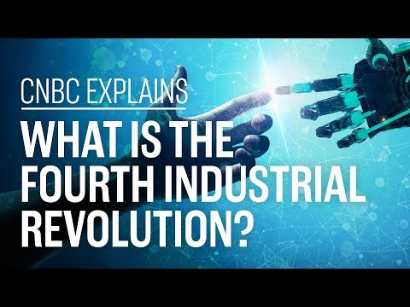
Notes:
https://www.cnbc.com/2019/01/16/fourth-industrial-revolution-explained-davos-2019.html

Slide 3
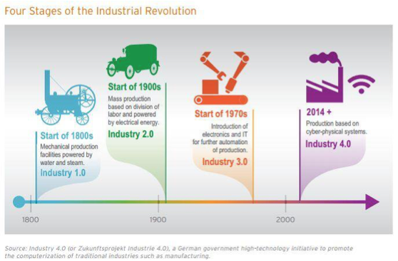

Slide 4
What is the Fourth Industrial Revolution?
Klaus Schwab, founder and executive chairman of the Geneva-based WEF, published a book in 2016 titled "The Fourth Industrial Revolution" and coined the term at the Davos meeting that year.
Schwab argued a technological revolution is underway "that is blurring the lines between the physical, digital and biological spheres."
Simply put, the Fourth Industrial Revolution refers to how technologies like artificial intelligence, autonomous vehicles and the internet of things are merging with humans' physical lives. Think of voice-activated assistants, facial ID recognition or digital health-care sensors.
Schwab argued these technological changes are drastically altering how individuals, companies and governments operate, ultimately leading to a societal transformation similar to previous industrial revolutions.
Notes:
Klaus Schwab, founder and executive chairman of the Geneva-based WEF, published a book in 2016 titled "The Fourth Industrial Revolution" and coined the term at the Davos meeting that year.
Schwab argued a technological revolution is underway "that is blurring the lines between the physical, digital and biological spheres."
Simply put, the Fourth Industrial Revolution refers to how technologies like artificial intelligence, autonomous vehicles and the internet of things are merging with humans' physical lives. Think of voice-activated assistants, facial ID recognition or digital health-care sensors.
Schwab argued these technological changes are drastically altering how individuals, companies and governments operate, ultimately leading to a societal transformation similar to previous industrial revolutions.

Slide 5
The first three industrial revolutions
Zvika Krieger, the head of technology policy and partnerships at WEF, told CNBC that there is a common theme among each of the industrial revolutions: the invention of a specific technology that changed society fundamentally.
The First Industrial Revolution started in Britain around 1760. It was powered by a major invention: the steam engine. The steam engine enabled new manufacturing processes, leading to the creation of factories.
The Second Industrial Revolution came roughly one century later and was characterized by mass production in new industries like steel, oil and electricity. The light bulb, telephone and internal combustion engine were some of the key inventions of this era.
The inventions of the semiconductor, personal computer and the internet marked the Third Industrial Revolution starting in the 1960s. This is also referred to as the "Digital Revolution."

Slide 6
Difference between Third and Fourth
Fourth Industrial Revolution is different from the third for two reasons: the gap between the digital, physical and biological worlds is shrinking, and technology is changing faster than ever.
For evidence of how quickly technological change is spreading, observe the adoption of the telephone. It took 75 years for 100 million people to get access to the telephone; the gaming app "Pokemon Go" hooked that many users in less than one month in 2016.

Slide 7
The Issues and Concerns
Some experts warn of a "winner-take-all economy," where high-skilled workers are rewarded with high pay, and the rest of workers are left behind.
A 2018 report by investment firm UBS found billionaires have driven almost 80 percent of the 40 main breakthrough innovations over the past four decades.
In 2016, Schwab predicted inequality would be the greatest societal concern associated with the Fourth Industrial Revolution.
"There has never been a time of greater promise, or one of greater potential peril"

Slide 8
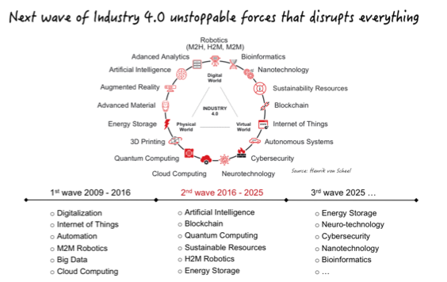

Slide 9
We are Way Behind the Developed Countries

Slide 10

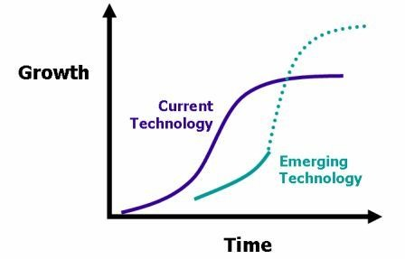
We have Adopted Leapfrog Strategy for Pakistan
Andrew Ng has proposed a brilliant strategy for developing countries that have fallen behind in the technology race.
The idea is to skip over the intermediary technologies and leapfrog into the future by adopting 4IR technologies.
With this approach, it is possible to achieve exponential growth in a shorter period of time.
Notes:
Andrew Ng (https://www.andrewng.org) is a Chinese English computer scientist, executive, investor, and entrepreneur, who co-founded and led Google Brain team and also was a VP & Chief Scientist at Baidu and currently he is an adjunct professor at Stanford University.

Slide 11
PIAIC will Focus on these 4IR Technologies
Artificial Intelligence (AI)
Internet of Things (IoT)
Cloud Native Computing
Blockchain

Slide 12
PIAIC will Apply 4IR Technologies on Pakistani Industry Verticals
To further transform its economy, PIAIC will also adopt Andrew Ng’s second strategy which is to develop it’s industries by applying 4IR technologies on industry verticals in they already have a competitive advantage.
For example, if a developing economy like Pakistan has a strong and thriving cotton spinning industry, then it has an advantage in applying AI, IoT, Blockchain and Cloud Technologies to cotton spinning industry.
PIAIC will target the top industries of Pakistan for adoption and implementation of 4IR technologies.

Slide 13
Fifteen Guiding Principles of PIAIC
Identify. Identify key areas where Pakistan can focus.
Cloud Native and Mobile Computing
Data Science and Artificial Intelligence
Blockchain and Decentralized Applications
Internet of Things
Target Student Body. The target student body of the PIAIC program includes students, professionals, and under-employed/unemployed individuals with any background.
Selectivity. Students are selected into the program after passing an English and Math based aptitude test where they compete with thousands of applicants for a limited number of seats.

Slide 14
Fifteen Guiding Principles of PIAIC - 2
Meritocracy. After selection, students are introduced to a completely merit based system in which any student that does not perform up to the mark is immediately removed from the system.
Continuous Quality Monitoring. We have prepared a series of internal exams, which students must attempt every 30-45 days, over the course of the program, that measure the students performance while also simultaneously preparing students for internationally recognized skill based certifications.
Funnel Management. Due to a lower quality of early childhood and general education, a wide array of socio-economic issues, and the difficulty of the PIAIC curriculum, it is estimated that about 10% of the students will complete the program successfully.

Slide 15
Fifteen Guiding Principles of PIAIC - 3
External Validation. After successfully completing the PIAIC program and earning the PIAIC certification, each graduating student will also be capable of passing the international certification exams that are required qualifications for PIAIC faculty.
Homegrown Faculty. The biggest challenge is in recruiting faculty for these latest state-of-the-art technology programs. There is already an extreme shortage of even the most basic CS subject matter experts. Recruiting international trainers is not feasible because of the difficulty of foreign faculty in communicating with the local students. After earning the international certifications required to become PIAIC Faculty and also familiarity with the PIAIC curriculum, having gone thru it themselves, the best PIAIC graduates who possess both the technical and communication skills required to become instructors are then be offered teaching positions at PIAIC.

Slide 16
Fifteen Guiding Principles of PIAIC - 4
Hybrid Delivery. PIAIC classes are offered as a hybrid of both online and onsite programs. Though online delivery of education may deliver significant outcomes in some parts of the world, online education systems have always resulted in failure in Pakistan. Because of low energy and a lack of drive, the majority of students require continuous motivation from faculty and peers to complete the trainings. All students are required to take the proctored exams onsite.
Large Class Size. PIAIC classes, like most state run universities in the United States, will have a large number of students. Because of the shortage of quality faculty, large class sizes means the possibility for a maximum number of students to participate in the programs. This also reduces the cost of the program because the cost of teaching is divided among the larger class. To facilitate students, teacher assistants (TA) are assigned to each class and are also available to students during clearly defined office hours.

Slide 17
Fifteen Guiding Principles of PIAIC - 5
Affordability & Flexibility. PIAIC course fees are extremely low. In just 1,000 per month, a student can participate in training programs that cost thousands of dollars in the global market. The fee for online students is Rs 500 per month. Most PIAIC classes are held either on the weekends or in the evenings, allowing almost anyone to participate.
Lean Startup. The PIAIC is a lean startup in every essence of the term. Our management follows the principles of the lean startup methodology to its core. Thru a validated learning and a continuous improvement iteration cycle, the PIAIC process delivers results quickly and is also quick to adapt & improve. PIAIC is operating as startups operate in Silicon Valley, USA. The program is totally privately financed.

Slide 18
Fifteen Guiding Principles of PIAIC - 6
Freelancing & Services will boast Software Exports. PIAIC graduates will have the option to join the technology industry as international freelancers or employees in technology services companies. They may also create new startups. This will boost the Pakistan software exports because these developers will be skilled in the latest, most in-demand technologies, earning a hourly rate above $30 USD.
Boost Domestic Industry Verticals. PIAIC will conduct research to determine how to implement 4IR technologies in domestic industry verticals to boost productivity and GDP.
Entrepreneurship. The PIAIC programs are geared towards producing graduates that can work in the global markets. Instead of waiting for job offers, students will be trained to create startups and generate revenue in freelancing.

Slide 19
The Internet of Things (IoT) will power the Fourth Industrial Revolution
The Fourth Industrial Revolution is changing the very software-defined automation allows manufacturers to link all stages of the value chain, rapidly adapt to changing markets, and create highly personalised products on a mass scale.
The opportunities presented by this revolution are incredible. According to McKinsey, the economic impact of smart factories could reach up to $2.3 trillion per year by 2025.
At the heart of the Fourth Industrial Revolution is the Internet of Things (IoT), which uses digital technology to connect sensors, actuators, and machines to each other and to factory workers.
Notes:
https://www.intel.com/content/dam/www/public/us/en/documents/white-papers/fourth-industrial-revolution-white-paper.pdf
https://www.weforum.org/agenda/2017/06/internet-of-things-will-power-the-fourth-industrial-revolution/
https://www.zdnet.com/article/how-iot-will-drive-the-fourth-industrial-revolution/

Slide 20
What is IoT?
The Internet of Things, or IoT, refers to the billions of physical devices around the world that are now connected to the internet, collecting, sharing and analyses of data.
Thanks to cheap processors and wireless networks, it's possible to turn anything, from a pill to an aeroplane to a self-driving car into part of the IoT

Slide 21
Definition
The Internet of Things is the network of physical devices that combine IP connectivity with software, sensors, actuators, and other electronics to directly integrate the physical world into our computer-based systems, resulting in efficiency improvements and economic benefits.
Simpler Definition:
The Internet of Things is a network of Internet connected devices that communicate embedded sensor data to the cloud for centralized processing.

Slide 22
IoT is about Billions of Devices
The Internet of Things, or IoT, refers to the billions of physical devices around the world that are now connected to the internet, collecting, sharing and analyses of data.
Thanks to cheap processors and wireless networks, it's possible to turn anything, from a pill to an aeroplane to a self-driving car into part of the IoT

Slide 23
The Current and Future Impact of IoT
The IEEE has compiled data and makes the following claims about its current and future impact:
In 2015, the global wearables market had already increased 223% from the previous year (and data on Statista shows it increasing by another 243% between 2015 and 2022)
By 2020, 250 million vehicles will be connected to the Internet
IoT will add 15 trillion dollars to the global economy over the next 20 years
There will be 50 billion Internet-connected devices by the year 2020.
Notes:
As the market becomes more mature, these figures will no doubt change but the current trend looks as if IoT is not only here to stay but positioned to make a substantial impact both socially, in business, and economically.
[^1]: Source: https://www.comsoc.org/blog/infographic-internet-things-iot
[^2]: Source: https://www.statista.com/statistics/437871/wearables-worldwide-shipments/

Slide 24
Benefits of IoT
The interconnection of these multiple embedded devices will be resulting in automation in nearly all fields and also enabling advanced applications. This is resulting in improved accuracy, efficiency and economic benefit with reduced human intervention. The major benefits of IoT are:
Improved Customer Engagement
Technical Optimization
Reduced Wastage
Integrate and Adapt Business Model
Better Business Decision

Slide 25
IoT Enabling Factors
Miniaturization
Connectivity
Advanced power sources and power management
Inexpensive processors, sensors, and actuators
Cloud-based processing
Ubiquitous computing

Slide 26
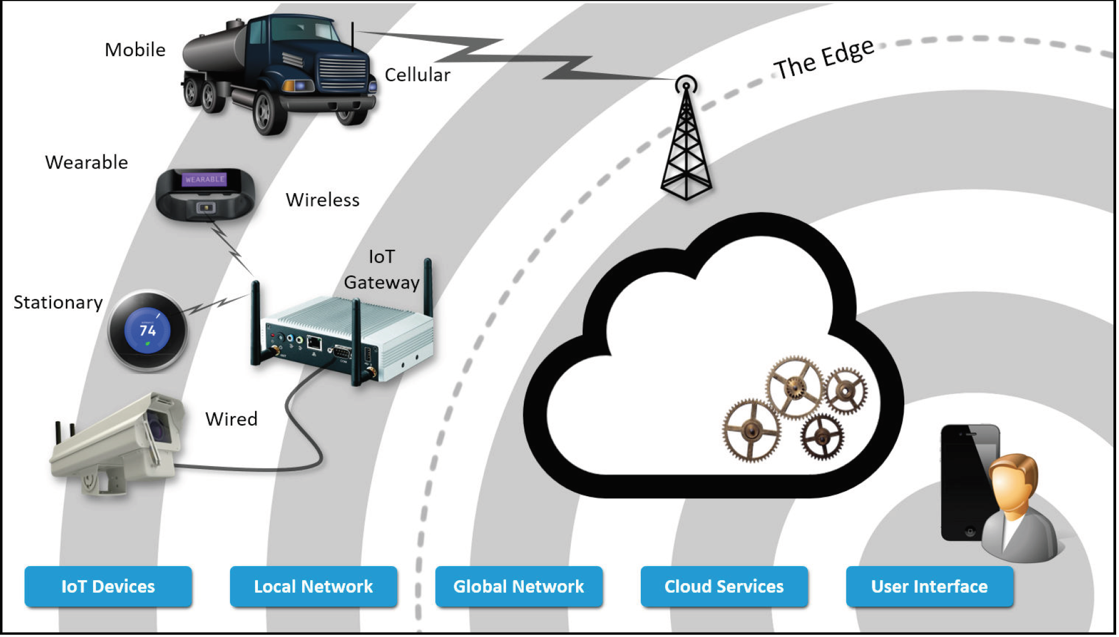
Components of IoT architecture

Slide 27
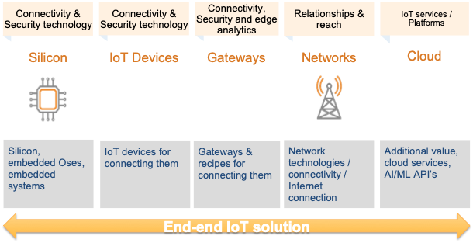
End-to-end IoT

Slide 28
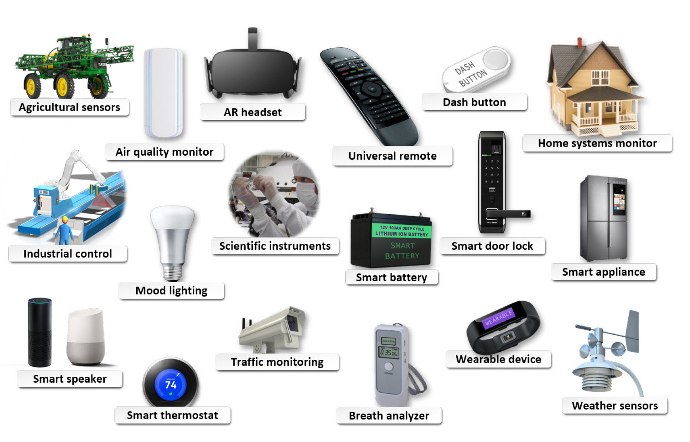
Example IoT Devices

Slide 29
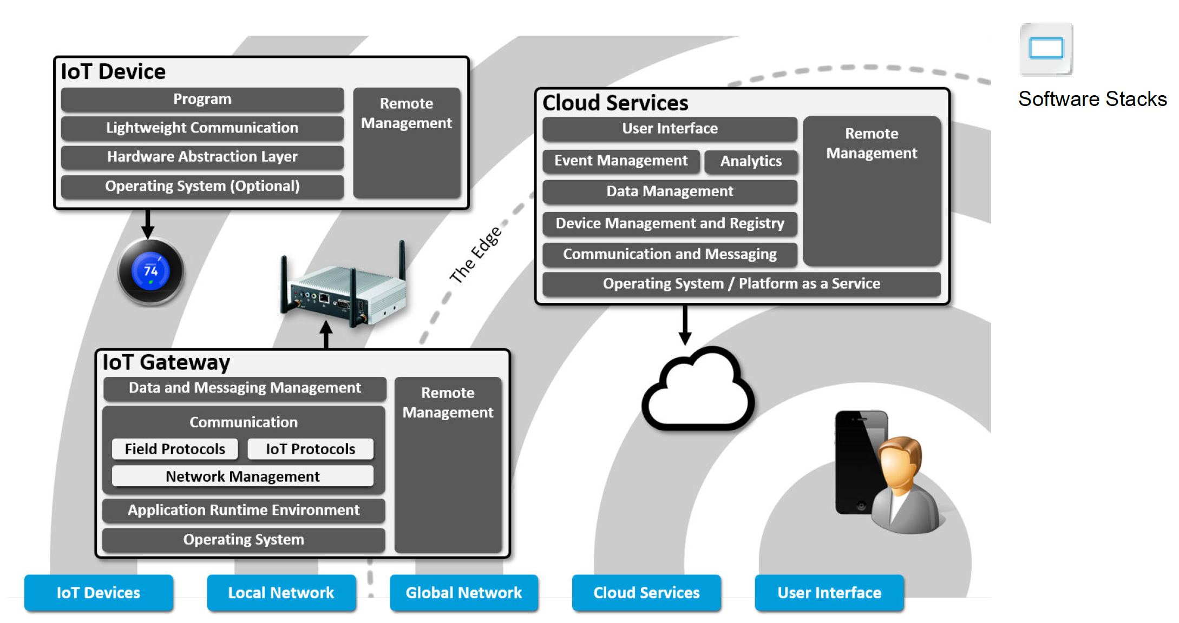
Software Required

Slide 30
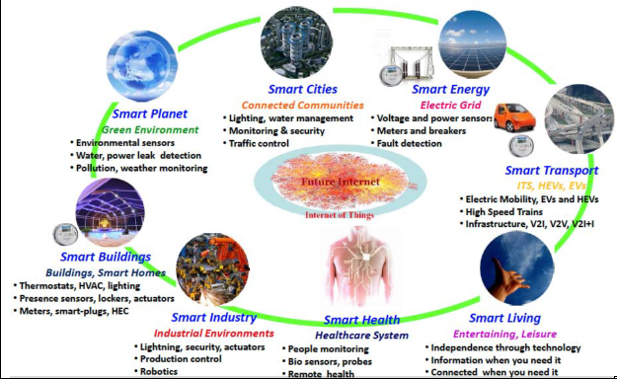
Applications of IoT

Slide 31
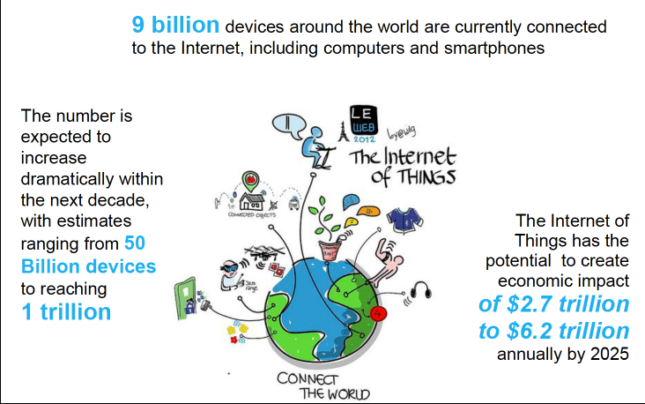
Introduction to IoT

Slide 32
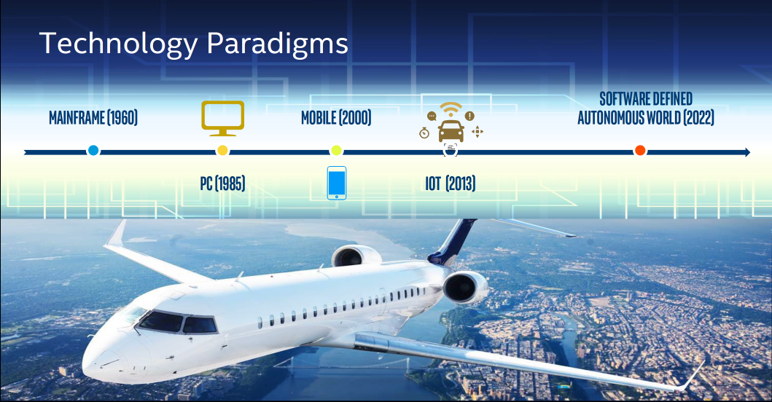
Where we started

Slide 33
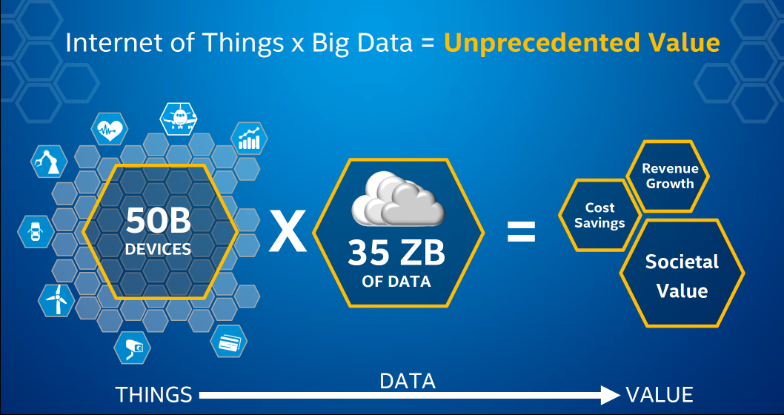
Value Proposition

Slide 34
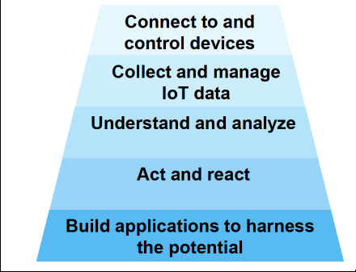
Layers of IoT

Slide 35
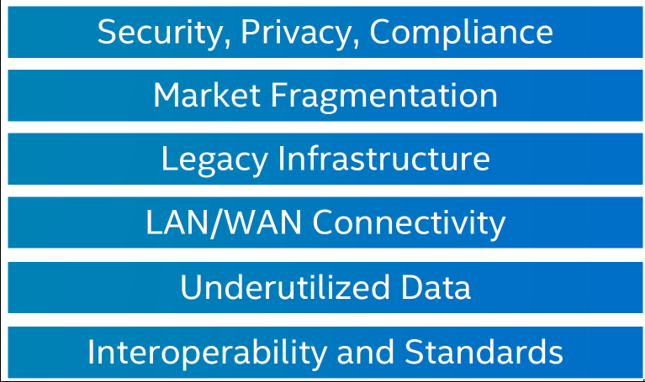
Challenges to IoT

Slide 36
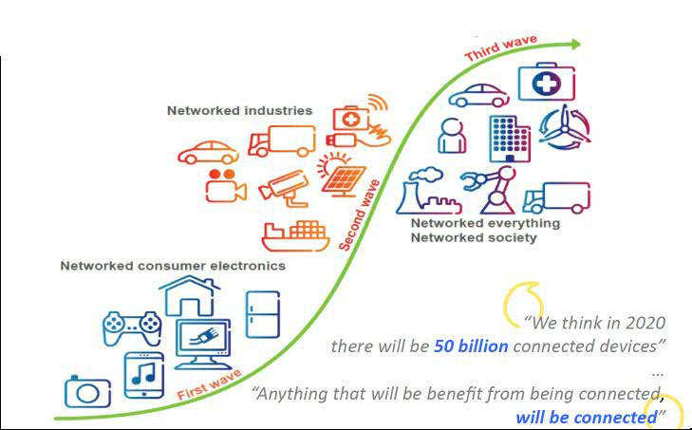
Past, Present and Future of IoT

Slide 37
IoT Example: The Refrigerator
A refrigerator is just a thing, so it can be anything besides a computer.
If it's a computer, we're not calling that a thing, but anything besides a computer.
Now the next thing you do is you add to that some type of computational intelligence (Micro controller).
So that's intelligent refrigerator. But maybe you wouldn't call that Internet of Things, cuz it's not actually networked yet. Then, to top it off, you add Internet connectivity.
It's got some kind of computation inside and it's got a network connection which means it can use all sorts of other resources that are not local.
Notes:
Watch video 01_IoT Refrigrator Example

Slide 38
IoT Example: What the IoT Refrigerator can do
You can have IoT fridge detect that you are low on butter and then just order that, and then the next morning, butter will appear on your doorstep.
You can search for low food prices.
Give you a good idea for food for you tomorrow is this type of meal that you've had in the past.
IoT device should have a simple interface, have computational intelligence and be connected to the internet.

Slide 39
IoT Devices vs Computers
IoT Device has a main function separate from Computation
Cars drive, Phone make calls, TVs displays shows
Computation is a means to an end
Computers main function is to compute, they are general purpose machines
IoT Devices are Special Purpose Devices, software and hardware are efficient for the task - but inefficient for other tasks
Notes:
Watch Video 02 IoT Devices vs Computers

Slide 40
Technological Trends that lead to IoT
Cost of hardware has decreased allowing to be added to devices
Smaller size and lesser weight needed to incorporate computation into devices
Computation ability has increased tremendously
Internet is available everywhere
Wireless Access (4G, Wi-Fi) has become cheap and ubiquitous, 5G on the way (No physical cables required)
Data transmission cost is fairly low, internet bandwidth is high
Cloud computing is being used extensively (IoT devices are a window to these cloud services)
Rise of Open Source Software (Rust, Web Assembly, Docker, Kubernetes, etc.)
Notes:
Watch 03 Trends that lead to IoT

Slide 41
What are Embedded Systems?
IoT devices are embedded systems
Computer based Systems that do not appear to be computers - complexity is hidden from the users
The complexity is embedded inside the device (that is where the name came from)
IoT devices are always connected to the internet
Embedded systems may have computational complexity but may or may not be connected to a network
Things are moving from Embedded to IoT, a lot of thing were Embedded but are now IoT
Sometime an Embedded System does not interact with the user but with another system, invisible to the user (Disk drive, anti lock braking system)
Notes:
Watch 04 What are Embedded Systems

Slide 42
Efficiency Rules in Embedded Systems
Most embedded systems are in cost-critical markets (e.g. consumer products)
Other Applications are in performance or power critical markets (e.g. military, medical)
It not that we just want it to work but we want it to work under tight constraints
Cannot depend on Moore’s Law to save you in the long run, it has to perform from day one

Slide 43
Embedded Systems vs Regular Platform Design
Embedded devices are generally application specific. Embedded systems are made to do one thing or one related set of things.
Unlike desktop, laptop computers which can run any type of program or pretty good doing any type of program.
When you know that the device is gonna do one thing, you design it for the one thing, you don't design it for everything.
A general purpose machine is overpowered.
But embedded systems are designed specifically and they let you change the way you do design, you can just put in the things that you need to put in. Spend money on what you need to put in. So, higher design efficiency is possible in Embedded System.
In embedded system you have understand both the software and hardware, which makes it more difficult.
Notes:
Watch 05 Embedded System Design

Slide 44
Embedded Systems Structure
Microcontroller
Sensors
Actuators
Data
Data
Receives data from the outside world

Slide 45
Microcontrollers
Integrated circuits that executes a program
Microcontrollers vs Microprocessors
Slower, 16 MHz - 500 MHz
Less memory, fewer features
Much cheaper
You write your program on computer, compile it and upload it to the flash memory of the microcontroller. As soon as there is power it runs the program.
We will use Rust and C to program microcontrollers

Slide 46
Sensors
Sensors just receive information from the environment.
Thermistor: Receives temperature information.
Photoresistor: It reports light intensity.
CMOS camera (digital camera): It captures images

Slide 47
Actuators
Actuators cause events to occur in the environment.
LEDs (light emitting diodes): they turn lights off and on
LCDs (liquid crystal displays): like what's on my digital watch
Servo motor: motors

Slide 48
Analog to Digital Conversion
Converts Analog Data to Digital Data
Used to interface with analog sensors
Analog to digital is the same as the difference between real numbers and integers
So the universe. The world in general to the perception of humans is analog.
Digital phenomena is something that's either off or on, or at least has some discrete number of states.
In order for our program on our microcontroller to be able to use information from sensors, that analog signal has to be converted to a digital value.
Now on the output end, you usually need digital to analog conversion. So let's say I have a microcontroller and it's outputting some sound to some speakers. These speakers are analog devices, they need analog signal.
Notes:
Watch 06 Analog to Digital

Slide 49
Microcontroller Characteristics
Architecture (ARM, ESP32)
Datapath bitwidth (4 - 128 bits)
Number of bits in each registry
Determine accuracy and data throughput
Input/Output pins
Need enough pins to support the application
Performance
The clock rates are slower than desktops
Notes:
Watch 07 microcontroller characteristics

Slide 50
Other Microcontroller Characteristics
Timers
Needed for real-time applications
Analog to Digital Convertors
Used to read input from analog sensors
Low power modes
Power saving is key
Communication protocol support
Interface with other IC’s
UART, I2C, SPI, etc.

Slide 51
IoT Devices are a Window to Cloud Services
Google Assistant and Alexa (processing is done on the cloud)
Netflix (Movie is not sitting on your phone but are in the cloud)
IoT devices give access to huge databases and computation resources on the cloud

Slide 52
IoT involves two essential components
A device-side (made up of individual devices) that acts as a data source
A cloud-side that gathers data and provides resources for analyzing it

Slide 53
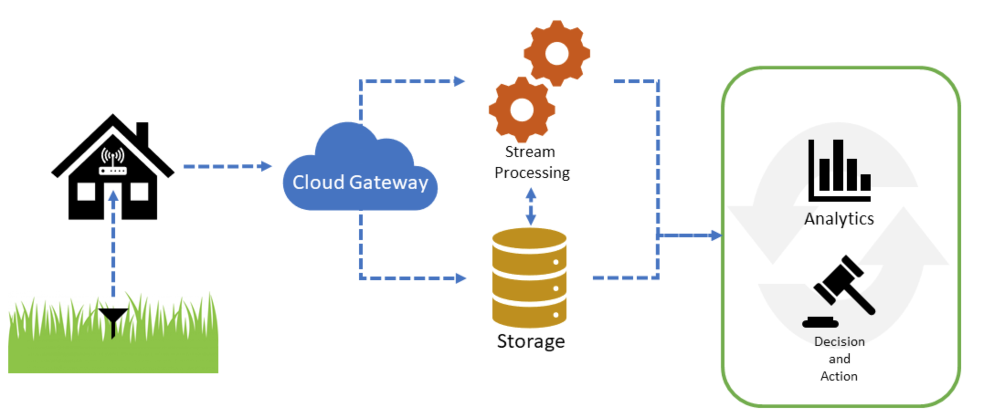
Example: Water Pricing During Summer
Notes:
An Example
Perhaps the best way to understand an IoT solution is to look at how one might be used in a true-to-life scenario. The specifics of this example are fictional but it should illustrate how the technology could be used. For more scenarios,see the list the IEEE is compiling here.
The Scenario
Suppose a small town is trying to figure out how to price water during the summer months. They want the town to look nice and enable people to keep their lawns green but they also don't want people wasting water which is in shorter supply during the summer. The town's officials need data to determine how often people actually need to water their lawns to keep them green and will use those data to help inform what price they should put on water usage during the summer.
The IoT Solution
The Devices
In order to collect they data they need, the town's officials select 100 houses at random across the town and ask them to install a small water sensor in their lawns that will detect the amount of moisture in the soil and send that data over the home's Wi-Fi connection to a central cloud service that will collect and store the data. The devices have the following requirements:
They must be small and unobtrusive.
They must be able to connect to Wi-Fi and be monitored by the home owner.
They must be battery operated and be able to run for 6 months without needing a new battery.
They must be able to detect moisture in the soil in percent saturation.
Must be able to store data for a 24-hour period in case the connection with the Wi-Fi router is lost.
Must be able to provide a rudimentary failure signal.
There could be a lot of other device requirements but these are the basics the device must contain. City engineers visit each house that has agreed to install the sensor, places the device in the yard at an optimal location, connects the device to the home's Wi-Fi router, and tests the connection with the cloud service.
The Data
The devices are programmed to collect moisture data every hour for a 24 hour period and average the readings to form a single number that is sent to the cloud service for storage. The dataset includes the device ID, the GPS location, a time/date stamp, and other relevant metadata.
The Cloud Service
City engineers developed a cloud-based solution to listen for incoming data from each device and collect that data in a database. The cloud service also listens for failure signals and can alert city engineers of an actual or pending device failure. The cloud services include an IoT gateway that handles communication with the devices, a storage solution to store the data, stream analytics service to manage the data coming in from the devices and an analytic services to analyze the data and inform decision making.
Analytics and Assessment
In our scenario, the town officials may use this data to understand better how often people actually are watering their lawns, how much they need to and make recommendations both to homeowners as well as policy makers about water usage and costs. Since weather is variable, the city engineers may need to collect data for many months to get accurate and actionable data. But the first step always is to collect the data in the first place and that's the power of IoT.

Slide 54
Categories of IoT devices and services: Maker IoT
The term "maker" has come to be equated with “hobbyist” and refers to those who like to build things to experiment or for personal use out of electronic components. When it comes to IoT, the idea of building unpolished but functional devices that collect data, using cloud services to gather and store that data, and maybe even doing analytics on the data collected all is a part of what is included in this category. But a commercial business may employ a maker's approach to experiment with ideas, create proof-of-concept devices, do costing, and other planning exercises. So "maker" need not be limited to hobbyists but describes an approach to development.
Notes:
“Maker” IoT. The term "maker" has come to be equated with “hobbyist” and refers to those who like to build things to experiment or for personal use out of electronic components. When it comes to IoT, the idea of building unpolished but functional devices that collect data, using cloud services to gather and store that data, and maybe even doing analytics on the data collected all is a part of what is included in this category. But a commercial business may employ a maker's approach to experiment with ideas, create proof-of-concept devices, do costing, and other planning exercises. So "maker" need not be limited to hobbyists but describes an approach to development.
Consumer IoT. As we'll see in the next topic, consumer IoT largely consists of commercial devices and associated services that are geared towards home or personal use such as connected thermostats or appliances. While the basic IoT concepts apply, the scope of what the devices collect, how they manage and store data, and how the data is used may be much more limited than what you'd find in an enterprise environment.
Enterprise IoT. Whereas Consumer IoT is focused on “turnkey” device solutions that solve specific problems or enable new scenarios for individuals or homes, enterprise-class IoT is focused on solving specific business problems like efficiency, reducing waste, increasing speed to market or of production, and providing intelligence on how business systems are running. A single enterprise may deploy dozens of devices that work in concert to give a business a single view of a factory or fleet of planes or gas pipeline. Enterprises also may require real-time data and real-time analysis of those data in order to make just-in-time adjustments or prevent disastrous consequences from a failed system. Consumer-grade IoT products rarely require this so the type of architecture needed in an enterprise will be more involved and require more services than a consumer solution requires.

Slide 55
Consumer IOT
It largely consists of commercial devices and associated services that are geared towards home or personal use such as connected thermostats or appliances. While the basic IoT concepts apply, the scope of what the devices collect, how they manage and store data, and how the data is used may be much more limited than what you'd find in an enterprise environment.

Slide 56
Enterprise IoT
Whereas Consumer IoT is focused on “turnkey” device solutions that solve specific problems or enable new scenarios for individuals or homes, enterprise-class IoT is focused on solving specific business problems like efficiency, reducing waste, increasing speed to market or of production, and providing intelligence on how business systems are running. A single enterprise may deploy dozens of devices that work in concert to give a business a single view of a factory or fleet of planes or gas pipeline. Enterprises also may require real-time data and real-time analysis of those data in order to make just-in-time adjustments or prevent disastrous consequences from a failed system. Consumer-grade IoT products rarely require this so the type of architecture needed in an enterprise will be more involved and require more services than a consumer solution requires.

Slide 57
IoT for Manufacturing
Microsoft highlights the following benefits for implementing IoT solutions in a manufacturing scenario:
Improved visibility across your manufacturing operations—make more informed decisions with a real-time picture of operational status
Improved utilization—maximize asset performance and uptime with the visibility required for central monitoring and management
Reduced waste—take faster action to reduce or prevent certain forms of waste, thanks to insight on key production metrics
Targeted cost savings—benchmark resource usage and identify inefficiencies to support operational improvements
Improved quality—detect and prevent quality problems by finding and addressing equipment issues sooner
Notes:
Each of these items can enable a manufacturer to improve efficiency and reduce waste, increase safety (for both workers and customers), help drive profitability by using real-time data to make decisions and, with automation, make real-time adjustments to processes.
https://azure.microsoft.com/en-gb/overview/iot/industry/process-manufacturing/?site=mscom_iot

Slide 58
IoT enabled Smart City
Telecom company AT&T describes the following benefits of a city fitted with smart devices that provide real-time data on things like parking, traffic, violent activities, and air quality:
Enhanced citizen safety
Optimized public services
Economic growth
Improved traffic flow
Improved environment
Empowered civic engagement
Notes:
Businesses can use data from these systems to improve products, innovate on new products to meet needs that may have been hidden or unknown without the data, and help cities solve seemingly intractable problems.
Here's an example. The popular traffic app Waze enables users to report on road situations in real-time like the existence of a dangerous pothole or other hazardous conditions. That data could be used by city officials to develop maintenance plans to address issues like these in more efficient ways that improve public safety. While this does involve some user interaction, it's easy to see how cars or street lamps could be fitted with artificial intelligence systems to detect conditions like these and report them in an automated way.
https://www.business.att.com/content/dam/attbusiness/briefs/iot-digital-infrastructure-brief.pdf

Slide 59
IoT enabled Retail
Analytics company SAS reports that IoT is starting to find its way into the retail experience. Using devices like RFID tags, mobile devices, and even digital signs, retail is embracing the advantages IoT can provide. The SAS report highlights five places where retail is using IoT to enhance their business and customer's experience:
Predictive Equipment Maintenance.
Smart Transportation.
Data-aware Warehouses.
Connected Consumer.
Smart Store.
Notes:
Analytics company SAS reports that IoT is starting to find its way into the retail experience. Using devices like RFID tags, mobile devices, and even digital signs, retail is embracing the advantages IoT can provide. The SAS report highlights five places where retail is using IoT to enhance their business and customer's experience:
Predictive Equipment Maintenance. As we've talked about, equipment, like refrigerators or point-of-sale devices, that are instrumented with IoT devices can help manufacturers predict failures and alert service staff when equipment needs to be maintained.
Smart Transportation. Internet-connected trucks and even products can help optimize the logistics around getting goods from one place to another.
Data-aware Warehouses. Retailers can outfit their warehouses with sensors and inventory tags so product placement in the warehouse can be optimized for easier access and quicker delivery. SAS anticipates that using automation, warehouses will “self-organize” to be the most optimal at all times.
Connected Consumer. Gone will be the days of mass marketing. Being aware of who is in your store can help you optimize sales or promotions to meet the needs of individual shoppers. Shoppers benefit because they can get a sale price on products that matter to them.
Smart Store. Imagine a mall that uses IoT to determine how customers shop and then enable mall planners to place stores that optimize around those patterns. SAS expects that this is on its way.
https://www.sas.com/en_us/insights/articles/big-data/five-iot-applications-retailers-are-using-today.html

Slide 60
IoT Adoption
In a 2018 blog post, Microsoft gave an overview of companies that are starting to use IoT solutions in what they call “Smart Buildings.” These companies are using IoT technology to help people navigate buildings, trigger maintenance requests, help engineers design better buildings and help property managers oversee their properties in a more efficient and effective way.
Technology company Intel is working with many companies to enable IoT solutions. Intel describes solutions that range from building smarter trains to smarter roads. They've helped a plastics company determine inefficiencies in their control system as well as improve their product cycle and reduce inventory risks. Intel's “wearables” solutions "improve worker efficiency and safety, including hands-free operations of industrial equipment."
Notes:
IoT Adoption
In the previous section, we talked about the opportunities business can take advantage of by adopting IoT solutions. While much of that is forward-looking, you may have come to see that IoT already is being adopted by many businesses and consumers.
In a 2018 blog post, Microsoft gave an overview of companies that are starting to use IoT solutions (specifically built on Azure IoT) in what they call “Smart Buildings.” These companies are using IoT technology to help people navigate buildings, trigger maintenance requests, help engineers design better buildings and help property managers oversee their properties in a more efficient and effective way.
Technology company Intel is working with many companies to enable IoT solutions. Intel describes solutions that range from building smarter trains to smarter roads. They've helped a plastics company determine inefficiencies in their control system as well as improve their product cycle and reduce inventory risks. Intel's “wearables” solutions "improve worker efficiency and safety, including hands-free operations of industrial equipment."
https://blogs.microsoft.com/iot/2018/06/05/smart-buildings-are-built-on-azure-iot/
https://www.intel.com/content/www/us/en/internet-of-things/solution-blueprints-and-case-studies.html

Slide 61
IoBT, Software and Combat Clouds
Internet of battlefield things (IoBT) - Military planners envision a future battlefield defined by the internet of things, one in which smart devices, soldier-worn sensors and unmanned aircraft produce a nonstop torrent of actionable data.
Software defined aircraft - All revealed fifth-generation fighters use commercial off-the-shelf main processors to directly control all sensors to form a consolidated view of the battlespace with both onboard and networked sensors.
Combat clouds - Fifth-generation jet fighters will operate together in a "combat cloud" along with future unmanned combat aircraft.
Notes:
https://www.c4isrnet.com/special-reports/military-it-modernization/2018/08/03/the-internet-of-things-will-depend-on-modernized-networks/
https://www.c4isrnet.com/opinion/2018/10/03/the-internet-of-battlefield-things-is-coming-are-it-pros-ready/
https://en.wikipedia.org/wiki/Fifth-generation_jet_fighter

Slide 62
An IoT Device
Connected to the Internet
Secure
Smart Features
Communication Capabilities with other devices
Remotely Configurable
Programmable
Replaceable (Optional)
Environmentally Flexible (Optional)
Notes:
An IoT Device
Here are some criteria that a device should meet to be considered an IoT device. Many of these properties are defined in the IEEE white paper on IoT and confirmed from other sources.
Connected to the Internet. The most obvious criterion is that the device has a connection to the internet with a unique identifier, and two-way communication. Both of these properties are important for a device to be considered a part of an IoT system. The device has to be unique to ensure secure communications with both the server and with other devices and the device has to be able to consume and deliver data. A primary value proposition for IoT is data collection as well as consumption.
Secure. Being able to uniquely identify a device on the internet or within an IoT ecosystem is one aspect of security but making a device secure also means it's resistant to being hacked (both the hardware and software), uses encrypted communication protocols, and is immune to mimicry either by an alternate hardware device or a virtual device.
Smart Features. This simply means that the device must have sensors or hardware that enable it to collect specific data based on events (like smoke in the air or a light being switched on or a key being turned). There is an implication that the device should be able to do this without user interaction so it has an “embedded intelligence.”
Communication Capabilities. The device should have the capability to communicate not only with cloud-based services but with other devices.
Configurable. The device should be remotely configurable or have the ability to self-adjust its configuration based on changes in the ecosystem. This includes the ability to automatically install updates, modify sensor receptivity, repair problems, and modify energy consumption among others.
Programmable. Like connectivity to the Internet, this should be a basic function of any connected device but certainly is true of IoT devices. The main idea here is that the function of the device should be able to be modified without having to make changes to its hardware. This may mean that a device has a number of sensors that could be activated or deactivated by software or, if a single-purpose device, the features should be able to be modified by software to accomplish a different task (for example, a thermostat that can deliver outside temperature readings from a service vs. taking the internal temperature readings from a sensor).
These probably wouldn't be considered “core” features but here are other properties to consider when defining a device as an "IoT device."
Replaceable. In many scenarios, when an IoT device fails (for example, a sensor on an airplane engine or wind turbine), the device should be able to be replaced and it's entire firmware and software settings loaded onto the device quickly and easily. This could mean that every programmable feature of the device should be able to be stored in the cloud and downloaded to a replacement device.
Environmentally Flexible. Depending on the scenario, the device should be able to maintain power, collect and store data, and smartly upload stored data in the event of a power outage, and/or loss of Internet connectivity.
https://iot.ieee.org/images/files/pdf/IEEE_IoT_Towards_Definition_Internet_of_Things_Revision1_27MAY15.pdf

Slide 63
Consumer versus Business Goals for IoT
Individual consumers implement cloud connected devices (such as doorbells, thermostats, and even refrigerators) in order to make their life easier, more comfortable, or more secure. Consumer devices in the home are not typically being used for the same purpose as an IoT device implemented in a business scenario.
In a way, business goals for IoT are simple compared with consumer goals. Businesses tend to implement IoT solutions in order to be more profitable, to increase safety for their work force, and to more easily comply with government regulations in order to create a better business environment. Profitability can be realized either directly through cost reductions or indirectly through competitive advantage. A business could use IoT to provide customers with improved service, resulting in increased market share (and overall profits). In most cases both the business and their customer benefit.

Slide 64
IoT Consumer Space Examples
Connected Refrigerators
Connected Doorbells and Cameras
Connected Thermostats
Notes:
While IoT in the consumer space is still fairly nascent, there regularly are new examples of the technology being used to improve customer experiences and expand product features. Here are a few scenarios (some with which you may already be familar):
Connected Refrigerators. The Samsung “Family Hub” line of refrigerators includes a large, touch screen that enables customers to more easily track their food inventory through the use of interior, web-enabled cameras, an easy-to-use shopping list, calendaring and TV mirroring features. While the element of data collection and analysis isn't central to this IoT solution, the refrigerator is an early look at the potential for connected appliances.
Connected Doorbells and Cameras. Many companies have gotten into the consumer doorbell and camera business. The Ring system and Google's Nest Hello device are examples. These doorbells record and store video and enable two-way voice and one-way video calling for people at the door. The Nest device will do facial recognition and use AI to determine which type of object it detects (car, person, animal).
Connected Thermostats. As we mentioned earlier, the connected thermostat is probably the most widely-used example of an IoT consumer device most likely because it was one of the first connected devices to check all the boxes in terms of using an IoT architecture. The most famous device is the Nest Thermostat but there are others. Microsoft recently released its GLAS thermostat in partnership with Johnson Controls and Honeywell has a line of connected thermostats. These devices enable customers to view and control their indoor temperature anywhere using a mobile device and an internet connection, set a heating and cooling schedule, view historical data on their home's temperature and energy consumption, and even get alerts when their heater's filter needs to be changed.
There are many other connected devices coming to market, that range from practical to weird. But the possibilities are nearly endless. Consumers are moving from a mindset of experimentation to anticipation that will soon evolve into expectation as connected devices enable customers to do more.

Slide 65
Business goals for IoT, improving:
Product Quality and Extended Product Lifetime
Service Reliability and Uptime
Operating Efficiency
Workforce safety
Governmental compliance
Notes:
Business goals for IoT focus on improvement in one or more of the following areas:
Product Quality and Extended Product Lifetime
Service Reliability and Uptime
Operating Efficiency
Workforce safety
Governmental compliance

Slide 66
IoT Verticals
Manufacturing
Smart City
Smart Building
Healthcare
Energy
Transportation and Smart Vehicles
Logistics and Inventory Management
Retail
Agriculture
Military
Notes:
IoT Business Scenarios
Bookmark this page
In this lesson, you will explore the ways that different businesses/industries (often referred to as “verticals” by industry experts to denote the depth of a solution rather than it's breadth) implement IoT solutions. Each vertical has their own specific needs and problems that must be addressed, so the IoT implementation within a vertical is often customized in some manner to address their requirements. Of course, there is a significant overlap between verticals, it's important to think through the needs of the industry for which you are creating an IoT solution.
As you might imagine, IoT can be implemented in both small and large businesses, and in nearly any type of business as well. Some of the industry verticals that have a high adoption rate are listed below. We won't be exploring all of theses verticals during this course, but we have selected a few that demonstrate the different approaches that may be applied by businesses within a vertical during the design and implementation of an IoT solution.
Manufacturing
Smart City
Smart Building
Healthcare
Energy
Transportation and Smart Vehicles
Logistics and Inventory Management
Retail
Agriculture

Slide 67
Core Subsystems of an IoT Architecture
devices (and/or on premise edge gateways) that have the ability to securely register with the cloud, and connectivity options for sending and receiving data with the cloud,
a cloud gateway service, or hub, to securely accept that data and provide device management capabilities,
stream processors that consume that data, integrate with business processes, and place the data into storage, and
a user interface to visualize telemetry data and facilitate device management.
Notes:
Core Subsystems of an IoT Architecture
Bookmark this page
At the core an IoT application consists of the following subsystems: 1) devices (and/or on premise edge gateways) that have the ability to securely register with the cloud, and connectivity options for sending and receiving data with the cloud, 2) a cloud gateway service, or hub, to securely accept that data and provide device management capabilities, 3) stream processors that consume that data, integrate with business processes, and place the data into storage, and 4) a user interface to visualize telemetry data and facilitate device management. Following, these subsystems are briefly described with prescriptive technology recommendations.
Cloud Gateway: The Cloud Gateway provides a cloud hub for secure connectivity, telemetry and event ingestion and device management (including command and control) capabilities.
Stream Processing: Processes large streams of data records and evaluates rules for those streams.
Business Process Integration: Facilitates executing actions based on insights garnered from device telemetry data during stream processing. Integration could include storage of informational messages, alarms, sending email or SMS, integration with CRM, and more.
Storage: Storage can be divided into warm path (data that is required to be available for reporting and visualization immediately from devices), and cold path (data that is stored longer term and used for batch processing).
User Interface: The user interface for an IoT application can be delivered on a wide array of device types, in native applications, and browsers.

Slide 68
IoT Sub-systems Description
Cloud Gateway: The Cloud Gateway provides a cloud hub for secure connectivity, telemetry and event ingestion and device management (including command and control) capabilities.
Stream Processing: Processes large streams of data records and evaluates rules for those streams.
Business Process Integration: Facilitates executing actions based on insights garnered from device telemetry data during stream processing. Integration could include storage of informational messages, alarms, sending email or SMS, integration with CRM, and more.
Storage: Storage can be divided into warm path (data that is required to be available for reporting and visualization immediately from devices), and cold path (data that is stored longer term and used for batch processing).
User Interface: The user interface for an IoT application can be delivered on a wide array of device types, in native applications, and browsers.

Slide 69
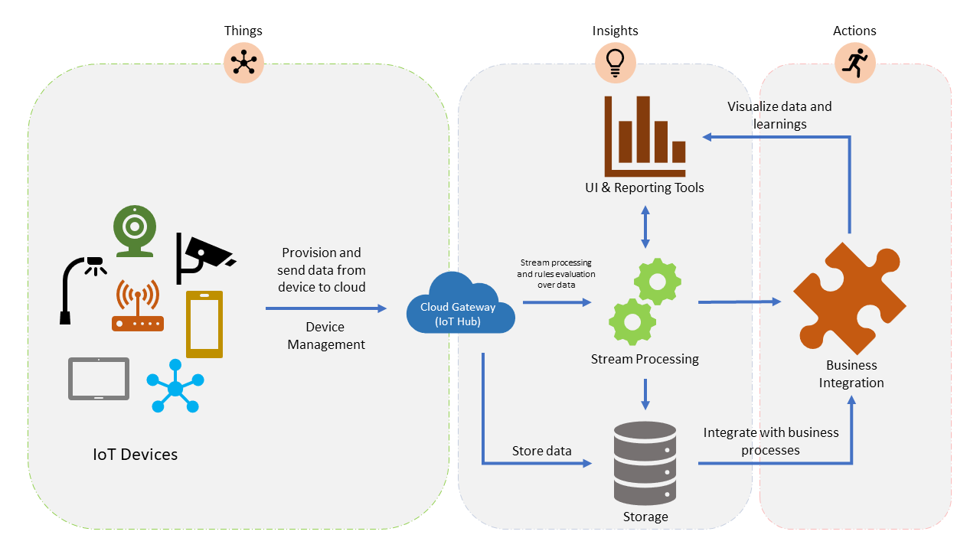

Slide 70
Optional Subsystems of an IoT Architecture
5. telemetry data transformation which allows restructuring, combination, or transformation of telemetry data sent from devices
6. machine learning which allows predictive algorithms to be executed over historical telemetry data, enabling scenarios such as predictive maintenance, and
7. user management which allows splitting of functionality amongst different roles and users.
Notes:
Optional Subsystems of an IoT Architecture
Bookmark this page
In addition to the core subsystems many IoT applications will include subsystems for: 5) telemetry data transformation which allows restructuring, combination, or transformation of telemetry data sent from devices, 6) machine learning which allows predictive algorithms to be executed over historical telemetry data, enabling scenarios such as predictive maintenance, and 7) user management which allows splitting of functionality amongst different roles and users.
Data transformation: The manipulation or aggregation of the telemetry stream either before or after it is received by the cloud gateway service (the IoT Hub). Manipulation can include protocol transformation (e.g. converting binary streamed data to JSON), combining data points, and more.
Machine Learning (ML) Subsystem: Enables systems to learn from data and experiences and to act without being explicitly programmed. Scenarios such as predictive maintenance are enabled through ML.
User Management Subsystem: Allows specification of different capabilities for users and groups to perform actions on devices (e.g. command and control such as upgrading firmware for a device) and capabilities for users in applications.

Slide 71
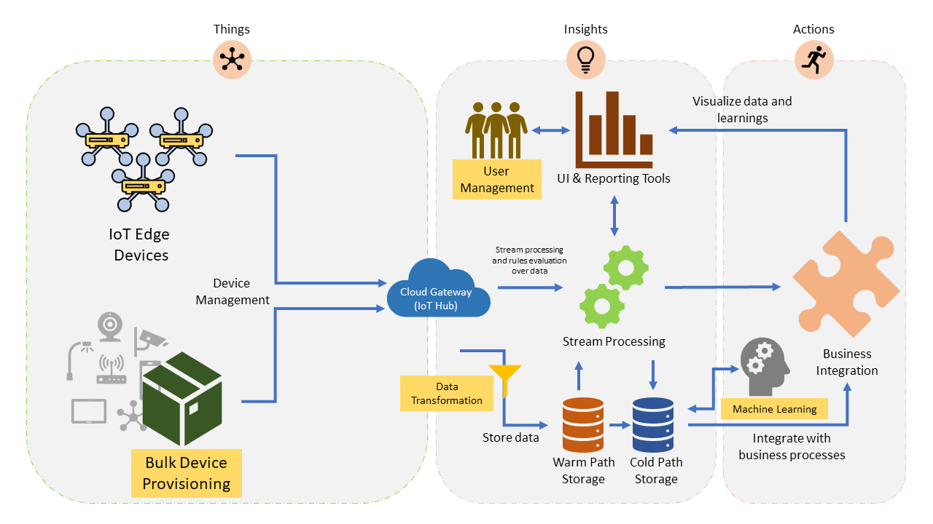

Slide 72
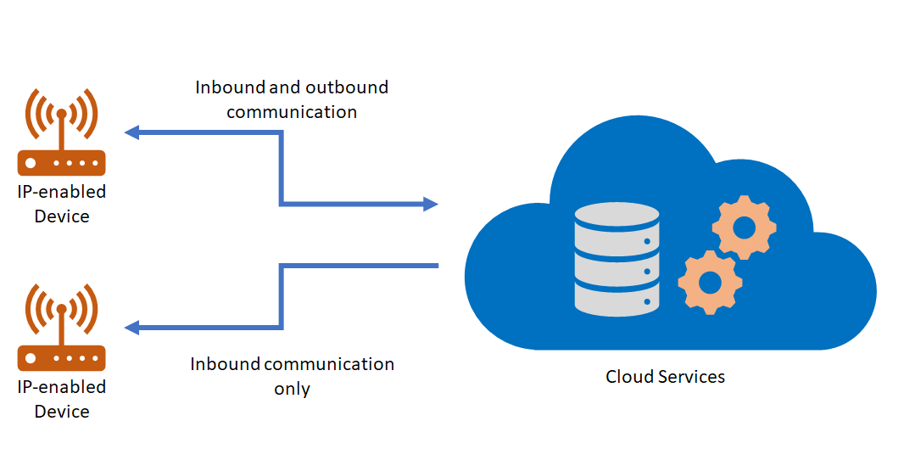
IoT Hardware: IP Enabled Devices
Notes:
IoT Hardware
In this topic, you'll learn:
About the different types of IoT hardware used in IoT solutions
How IoT hardware is being deployed and used in the real world
When thinking about building an IoT solution, perhaps the first area of consideration is what hardware you will need. This partly is driven by the fact that data is the main driver behind implementing many IoT solutions so figuring out what data you want to collect and how you want to collect it has a primary place in your architecture.
The hardware implemented in an IoT solution often includes a network infrastructure that is used to connect devices. Still, some devices could be stand-alone. How would this work? A sensor, for example, could collect temperature data or collect data about how a bridge is being stressed but not deliver those data immediately to a network database. A technician could come by on a regular schedule, collect the data from the device using an internet-connected tool which then delivers the data to the database.[^1]
[^1]: Though some argue that when a device no longer is able to connect to the internet, the “Internet” part of IoT no longer applies so the device shouldn't be considered an IoT device.
Other hardware involved in a broad IoT solution don't collect data at all but broker communication with other hardware and cloud services. In the following, we'll look at various types of hardware used in IoT solutions and talk about the role they might play.
IP-enabled Devices
An IP-enabled device is, simply, a device that can establish a a connection to a network (for many IoT devices, this means the internet) and have a unique identity on that network. “IP” stands for "internet protocol" and defines the way messages are delivered over a network. A message in networking terms is just a packet of information and single packet could deliver part of a text message or a video file. Most data that is transferred over the internet uses this communication protocol.
Examples
In terms of IoT, an IP-enabled device is one that can connect directly to a network like the internet and transmit or receive data. Examples we commonly think of are the home automation devices like doorbells and thermostats that use an internet connection to communicate with a central server. But industrial-grade IoT devices can be IP-enabled as well. IP-enabled devices require special hardware to enable this functionality.
Usage
As you might expect, people deploy IP-enabled devices in scenarios where data needs to be collected, delivered, and analyzed in real-time or near real-time. IP-enabled devices enable live connections to the other networked devices or services so data can be transmitted without interaction from a technician.
Data collection isn't the only reason to use an IP-enabled device. If transmitted data over the internet is particularly risky, your device may not have “outbound” ability enabled but the device still can receive messages (inbound) from the network so its firmware or software can be updated. Or it may have the ability only to send status messages but not any data it has collected.
While it's possible that a device may have only outbound communication abilities over IP, it's not typical since when delivering messages, it is important that the device knows if the receiving node has an error or if messages did not transmit for some reason. So some inbound communication typically is needed.

Slide 73
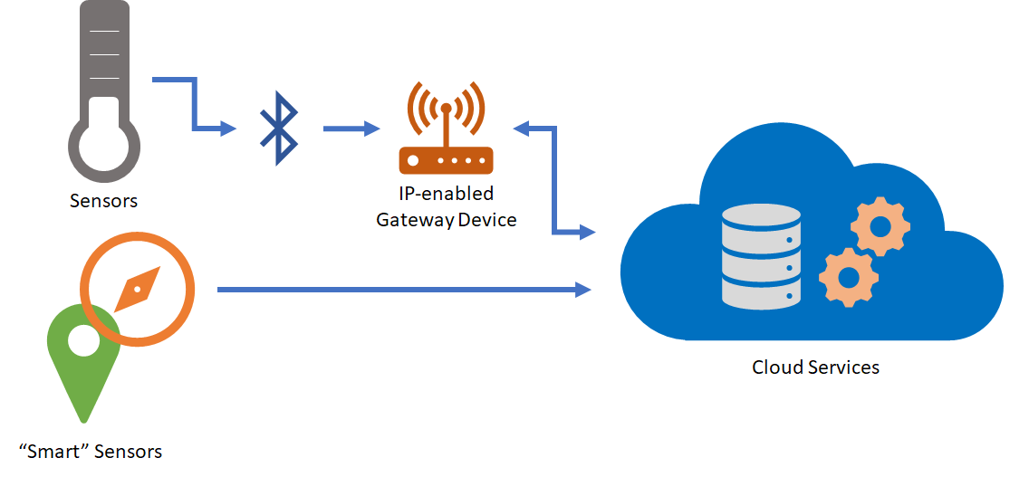
IoT Hardware: Sensors and Smart Sensors
Notes:
Sensors
We can break this category into two subcategories: sensors and smart sensors.
The IEEE, in their definition paper on IoT, writes this about sensors:
Sensors are one of the key building blocks of IoT. As ubiquitous systems, they can be deployed everywhere – from military battlefields to vineyards and redwoods and on the Golden Gate Bridge. They can also be implanted under human skin, in a purse or on a t-shirt. Some can be as small as four millimeters in size, but the data they collect can be received hundreds of miles away. They complement human senses and have become indispensable in a large number of industries, from health care to construction. Sensors have a key advantage in that they can anticipate human needs based on information collected about their context. Their intelligence, “multiplied” by numerous networks, allows them not only to report about the external environment, but also to take action without human intervention.
Within an intelligent networked system, sensors perform the functions of input devices – they serve as “eyes,” collecting information about their environment.
We can define a sensor, then, as a device that collects a specific type of data about the physical environment. As IoT as a technology grows, the list of available sensors most likely will grow with it. There also are communities that will help you build your own sensors if the one you need doesn't exist.
A smart sensor according to the website IoT Agenda is “a device that takes input from the physical environment and uses built-in compute resources to perform predefined functions upon detection of specific input and then process data before passing it on.” That is, the device itself processes the data to some degree before sending it to the next node in the IoT architecture.
Sensors of both types can be embedded on other devices which manages communication with a network or stand alone and handle all the necessary functions needed to collect and communicate data.
Examples
Sensors that can collect data on a wide variety of things actively are being developed. Intel has compiled a list of some sensors currently available. Examples include:
Temperature
Humidity
Energy
Compass
Pressure
Sonar
Light and UV
Usage
As should be clear from the above, sensors are used whenever a discrete bit of information needs to be collected about something in the physical environment.

Slide 74
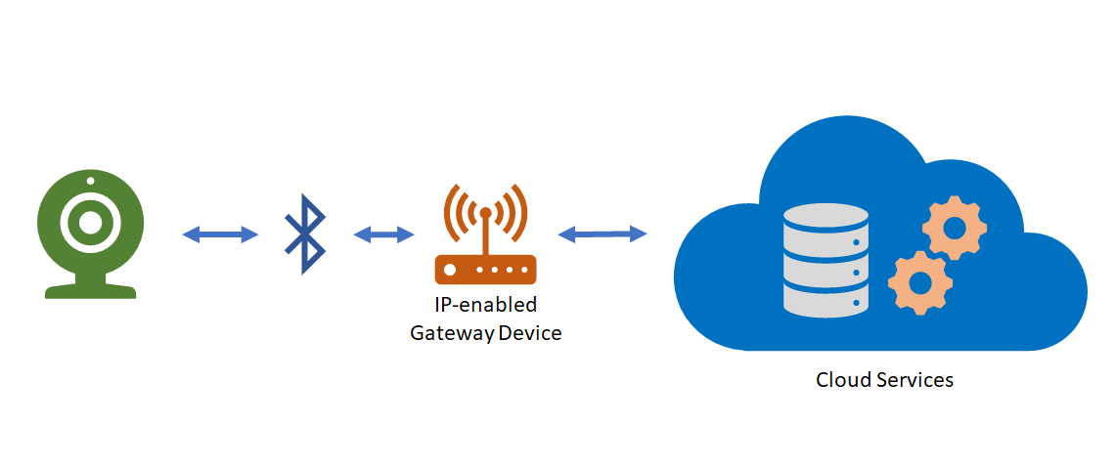
IoT Hardware: Non-IP Enabled Devices
Notes:
Non-IP Enabled Devices
As mentioned above, it's not necessary for a device to be IP-enabled in order to be a part of an IoT solution. Some devices don't use IP to connect to other parts of an IoT solution but can use other protocols. These devices don't connect to the internet per se but their messages are routed to the internet via other hardware like a field gateway which we'll discuss below.
Devices can use industry-specific protocols (such as CoAP5, OPC),and short-range communication technologies (such as Bluetooth, ZigBee) to connect to other hardware.
Examples
For example, when setting up an internet connected lock, you may need first to connect the lock to your phone using Bluetooth in order to set up a relationship with a cloud service. While this is a temporary situation, you can imagine a scenario where the device can only connect to a local device using Bluetooth and the secondary device brokers all the communication with the cloud service.
Usage
Devices of this type can be useful in scenarios where data from a number of devices needs to be aggregated, cleaned-up, and possibly even analyzed before being sent to a cloud service. Since IP-enabled devices typically take more resources, low-powered or resource- (or space-) constrained devices can use protocols with lower resource consumption requirements that transmit to a device that doesn't have these constraints.

Slide 75
Example of Sensors Available
Temperature
Humidity
Energy
Compass
Pressure
Sonar
Light and UV

Slide 76
Edge Devices and Field Gateways
A field gateway (edge) is a specialized device-appliance or general-purpose software that acts as a communication enabler and, potentially, as a local device control system and device data processing hub. A field gateway can perform local processing and control functions toward the devices; on the other side it can filter or aggregate the device telemetry and thus reduce the amount of data being transferred to the cloud backend.
Gateways in this context may assist in device provisioning, data filtering, batching and aggregation, buffering of data, protocol translation, and event rules processing.
Notes:
Edge Devices and Field Gateways
A field gateway is a specialized device-appliance or general-purpose software that acts as a communication enabler and, potentially, as a local device control system and device data processing hub. A field gateway can perform local processing and control functions toward the devices; on the other side it can filter or aggregate the device telemetry and thus reduce the amount of data being transferred to the cloud backend.
A field gateway’s scope includes the field gateway itself and all devices that are attached to it. As the name implies, field gateways act outside dedicated data processing facilities and are usually collocated with the devices.
A field gateway is different from a mere traffic router in that it has an active role in managing access and information flow. It is an application-addressed entity and network connection or session terminal. For example, gateways in this context may assist in device provisioning, data filtering, batching and aggregation, buffering of data, protocol translation, and event rules processing. NAT devices or firewalls, in contrast, do not qualify as field gateways since they are not explicit connection or session terminals, but rather route (or deny) connections or sessions made through them.

Slide 77
Edge Computing
Edge computing is a distributed computing paradigm which brings computer data processing and storage closer to the location where it is needed. So, instead of having a centralized, remote cloud to do all the work, the data is handled and stored locally, i.e. on the IoT device itself or at the nearest network node.
Computation is largely or completely performed on distributed device nodes.
Edge computing pushes applications, data and computing power (services) away from centralized points to locations closer to the user.
Edge computing does not need contact with any centralized cloud, although it may interact with one.
Edge application services reduce the volumes of data that must be moved, the consequent traffic, and the distance the data must travel. That provides lower latency and reduces transmission costs.
Notes:
https://en.wikipedia.org/wiki/Edge_computing

Slide 78
Why pure cloud computing isn’t the best option for IoT
Traditional cloud computing has a number of drawbacks when it comes to IoT:
Data security threats. Data is constantly being transmitted back and forth between the cloud and a device, and as such, the risk of privacy violation is heightened.
Performance issues. IoT applications rely heavily on real-time actions. Yet, the processing speed of your cloud-based app often depends on the actual distance between the device itself and the server location.
Operational costs coincidentally grow as the amount of data produced and shared increases.
On top of that, most data sourced to the cloud often bears no practical value and is never used.
Notes:
https://easternpeak.com/blog/the-impact-of-edge-computing-on-iot-the-main-benefits-and-real-life-use-cases/

Slide 79
How does edge computing work?
Every IoT sensor produces tons of data every second. In the case of cloud computing, the data is instantly transferred to the central, unified cloud database where it’s processed and stored.
If there’s any action required, the central server will send its response back to the device upon receiving and analyzing the acquired data.
While the whole process typically takes less than a second to complete, there might be situations when the response may be delayed or interrupted. This can happen due to a network glitch, weak internet connection, or simply because the data center is located too far from the device.
Now, in case of edge computing, you don’t need to send the data acquired by the IoT sensors anywhere. The device itself or the nearest network node (e.g. the router) is responsible for data processing and can respond in a proper manner if action is required.

Slide 80
Edge Computing makes it possible that the IoT device is no longer dependent on the internet connection and can function as a standalone network node.

Slide 81
The benefits for edge computing in IoT
Increased data security
Better app performance
Reduced operational costs
Improved business efficiency and reliability
Unlimited scalability
Notes:
The benefits for edge computing in IoT
As you can see, the main purpose of edge computing is to decentralize data handling. This leads to a number of advantages over the traditional cloud.
Namely, there are 5 main advantages of edge computing for IoT:
1.Increased data security
While IoT solutions represent a perfect target for cyber attacks, edge computing can help you secure your networks and improve overall data privacy.
Because the data is decentralized, distributed among the devices where it is produced, it’s difficult to take down the whole network or compromise all of the data with a single attack.
This approach is also preferred in terms of GDPR compliance: the less sensitive information is sent through your network and stored in your cloud, the better.
2. Better app performance
As mentioned above, it takes some time for the data travel back and forth between the device and the data center.
By storing and processing the data close to its source, you reduce the lag time and improve the overall app performance. As a result, you can analyze the data in real-time, without delays.
3. Reduced operational costs
When you store and process most of the data “at the edge”, you don’t need an abundance of cloud storage. Plus, you can filter out the unnecessary information and backup only the relevant data.
As a result, your infrastructure costs will inevitably go down.
4. Improved business efficiency and reliability
Lower data traffic and reduced cloud storage, in turn, lead to more efficient business operations.
Additionally, connection issues won’t be extremely problematic as they are for other IoT products that rely on the cloud. This is due to the fact that your devices can work autonomously, without internet connection.
5. Unlimited scalability
Unlike cloud, edge computing allows you to scale your IoT network as needed, without reference to the available storage (or its costs).
As a result of the listed benefits, edge computing really shines when it comes to time-sensitive tasks.

Slide 82
Edge Computing Use Cases
McKinsey finds that the industries with the most edge computing use cases are:
travel, transportation, and logistics
energy
retail
healthcare
utilities

Slide 83
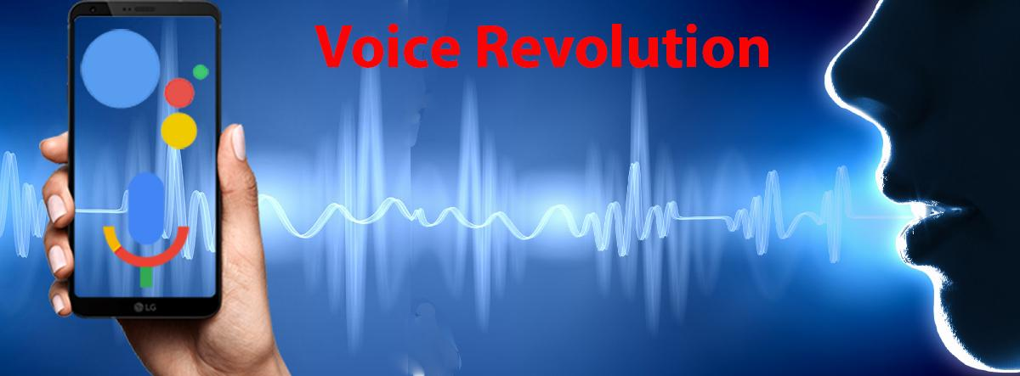
Voice Revolution

Slide 84
Voice control is most suitable in the following IoT use cases
Home automation
Automobiles
Health Care
Entertainment
Notes:
https://www.zeolearn.com/magazine/how-is-voice-recognition-affect-iot

Slide 85
Voice Assistants Are Taking Over Consumer IoT
No industry felt the heat of the voice assistant battle more than Consumer IoT (CIoT), in which voice assistant integrations became the primary focus for any CIoT product-centric company.
Imagine a future in which every command is at the tip of your tongue. When you wake up. your bathroom mirror can report your schedule for the day. During breakfast, you can ask the coffee machine for a latte, extra foam. On the train, your watch will tell you just how late you’ll be to work. In the office, your printer will pipe up, asking for more ink, please.
Notes:
https://www.iotforall.com/voice-assistants-consumer-iot/

Slide 86
Entry point into the IoT’s has been Amazon and Google’s smart speakers
For many consumers, the entry point into the Internet of Things has been Amazon and Google’s smart speakers.
Voice control is one of the primary drivers of smart home market growth with the number of home voice devices projected to reach 275 million by 2023 in USA alone.

Slide 87
Visions of dialogue from science fiction
Hal “2001: A Space Odyssey” (1968)
Naturally conversing computer
Star Trek (original 1966)
Natural language command and control
Her (2013)
A virtual partner with natural dialogue capabilities

Slide 88
A NEW KIND OF UI: VUI

Slide 89
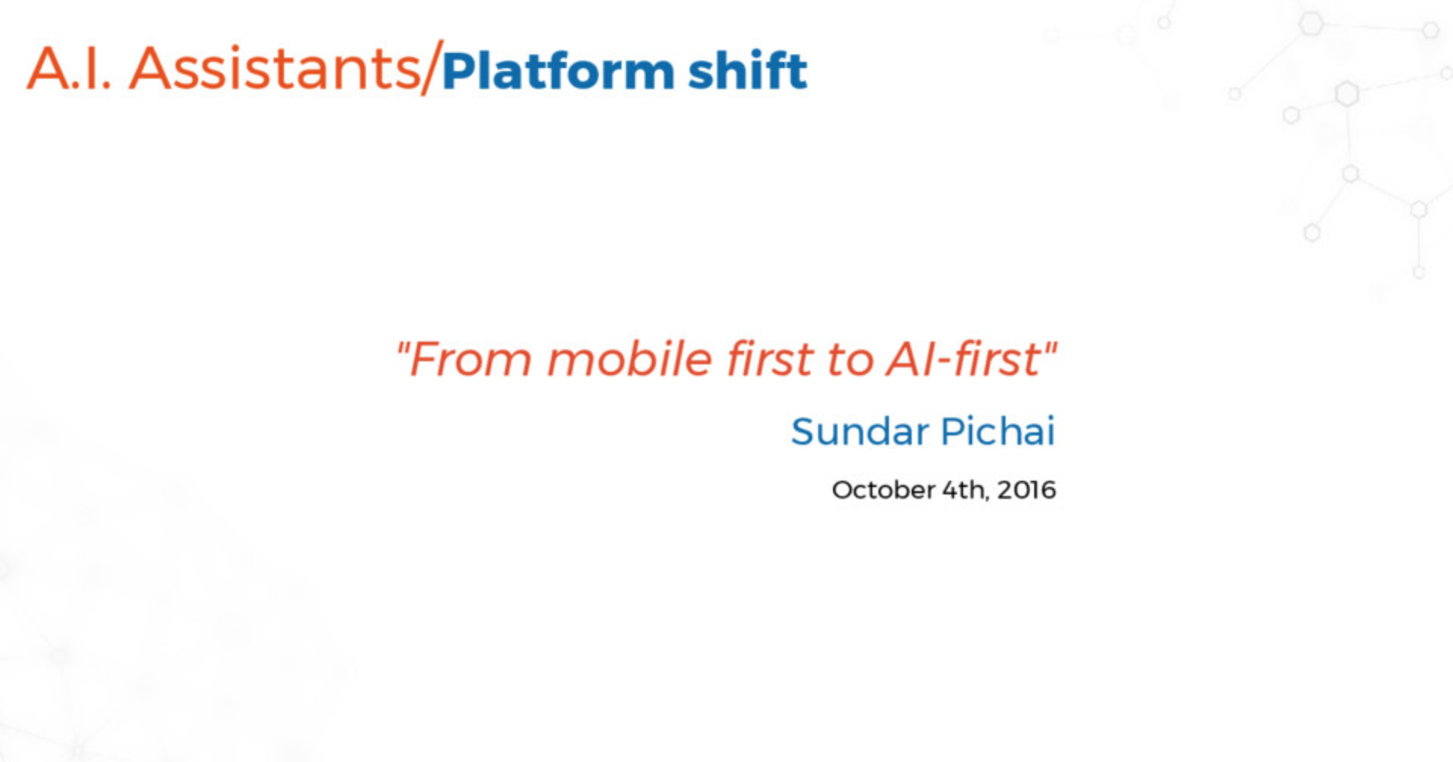

Slide 90
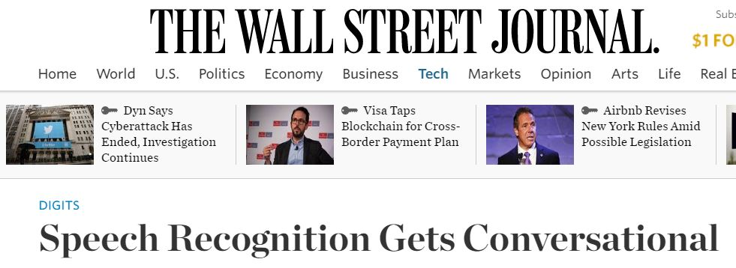
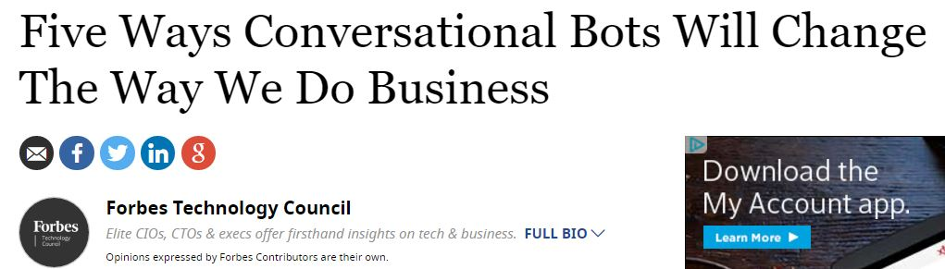
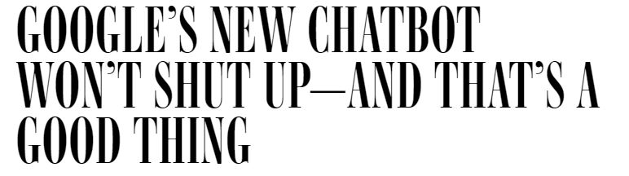


Slide 91
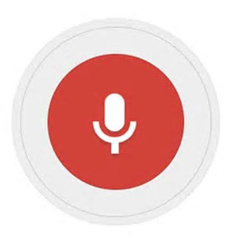
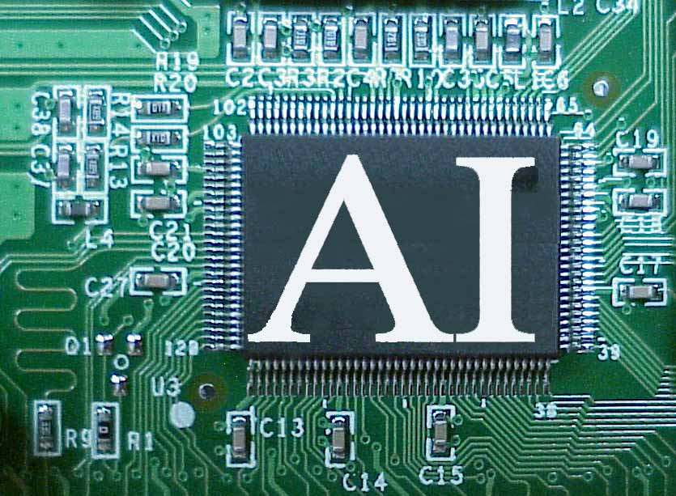
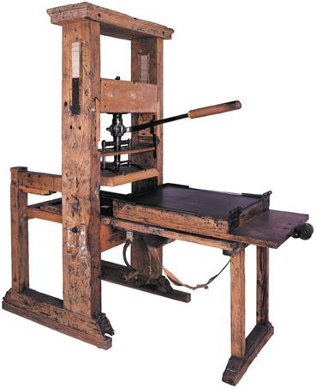
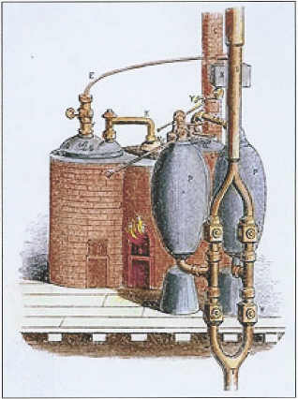



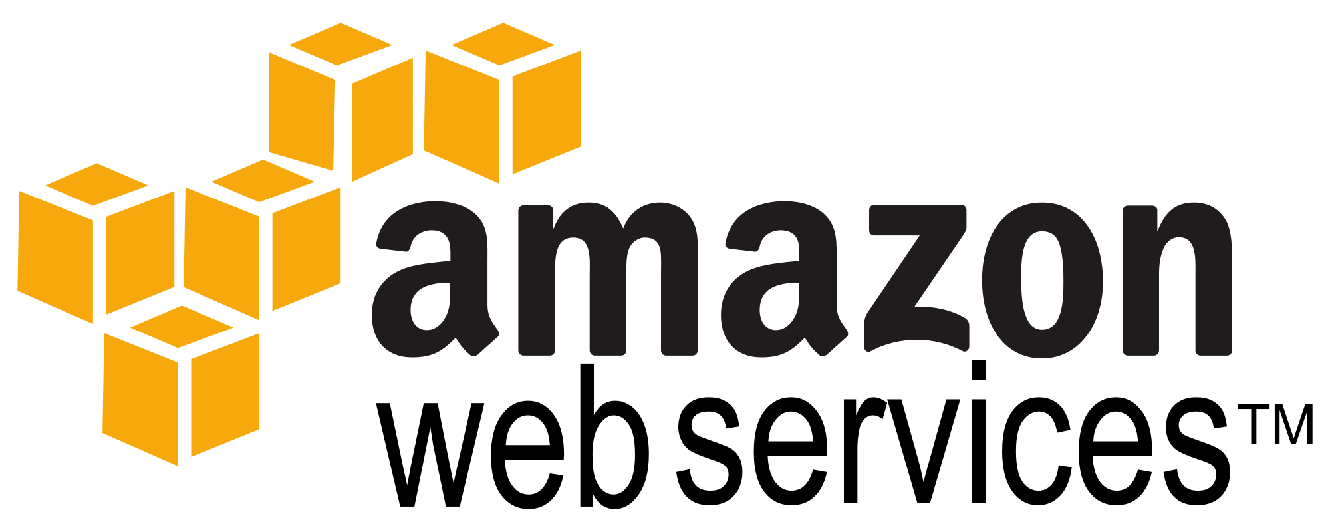
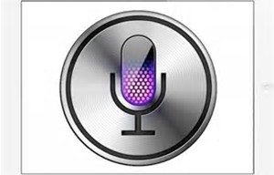
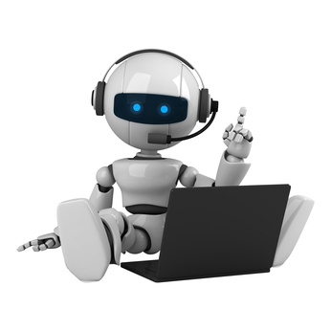

Technology revolutions
1456
1765
1943
1981
1994
2008
2014
2016

Slide 92
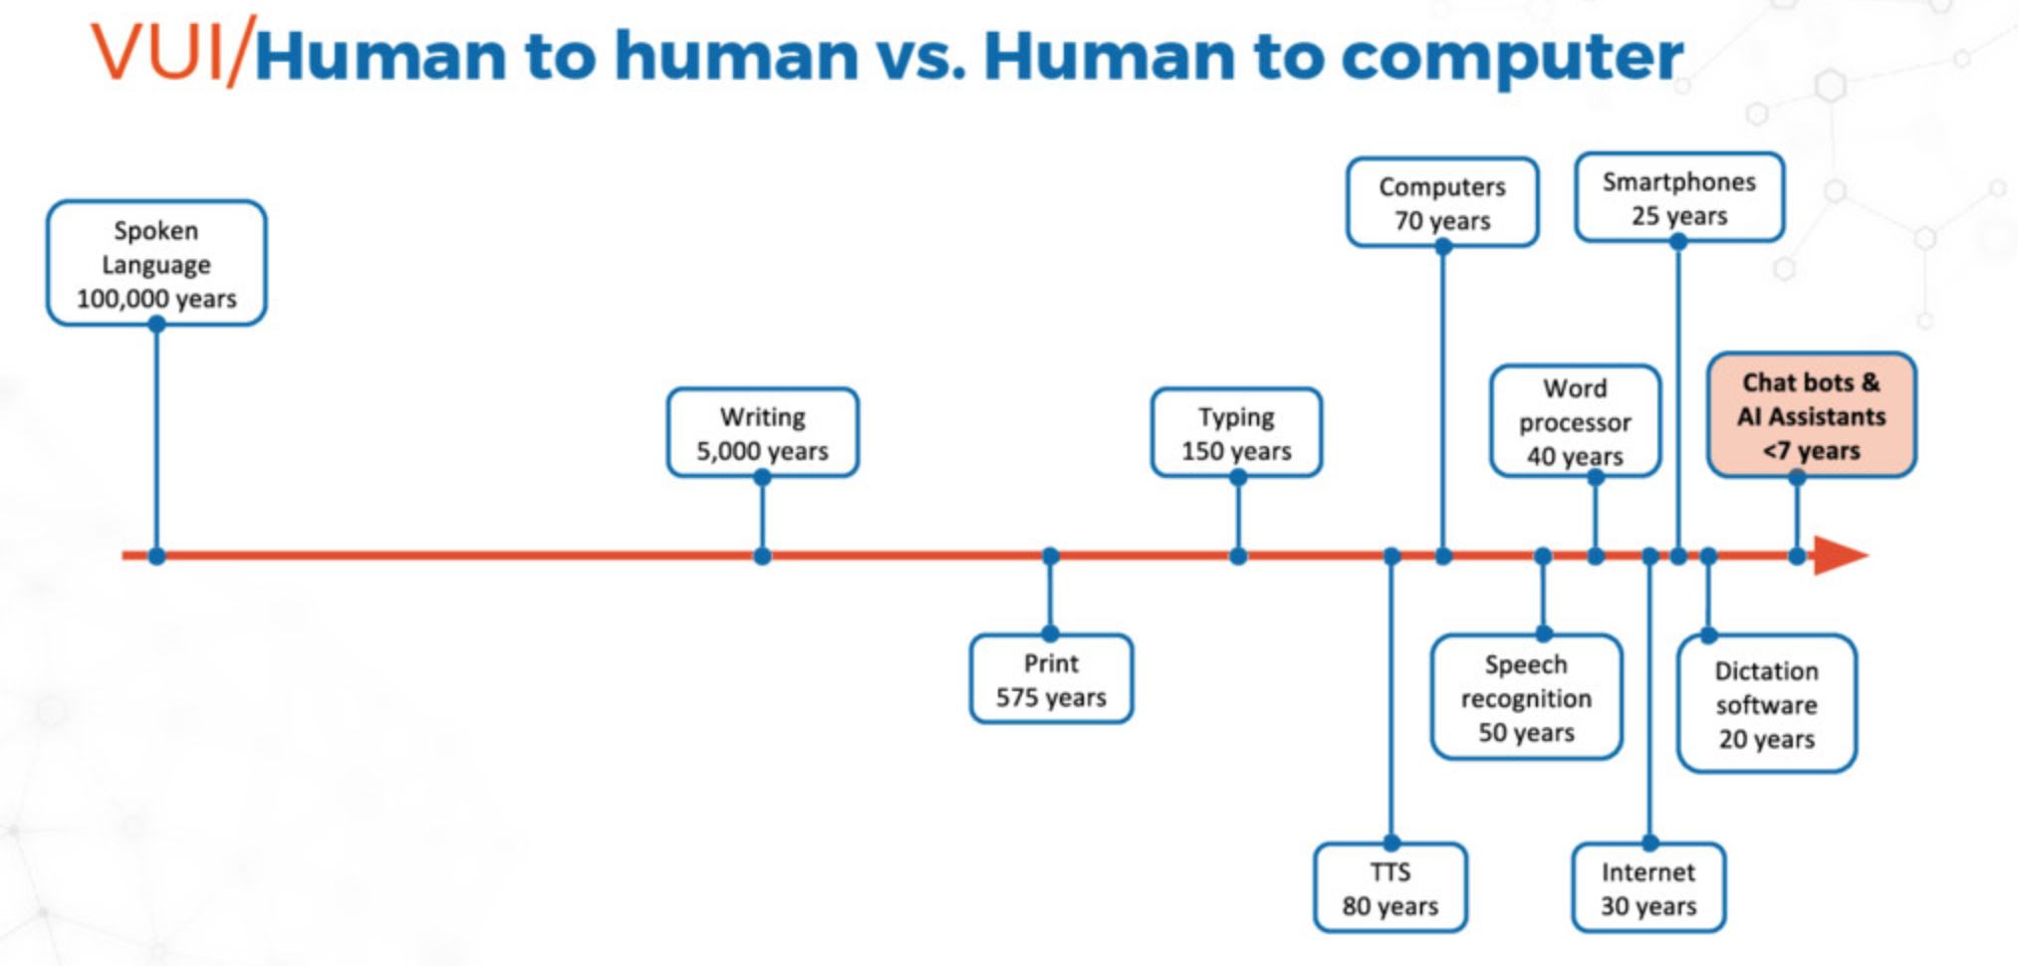

Slide 93
Digital Assistants are so Hot
The market for AI-driven personal assistants and bots will almost double in 2018, reaching more than $12 billion by 2020 with 1.6 billion active users, according to Statista.
Today, pretty much every tech giant is making digital agents for their customers. Amazon’s Alexa, Microsoft’s, Apple’s Siri and Google’s Assistant.

Slide 94
Reasons for being so Hot
Natural language is more intuitive than web or mobile interfaces, which usually entail some degree of a learning curve
Enhanced productivity
Personalization, goes far beyond voice recognition. They employ machine learning to refine their responses and deliver only relevant options based on consumer preferences
Personal assistants can access a large spectrum of data
AI-enabled assistants and innovations in the Internet of Things bring a whole new level of communication between devices, people, and companies

Slide 95
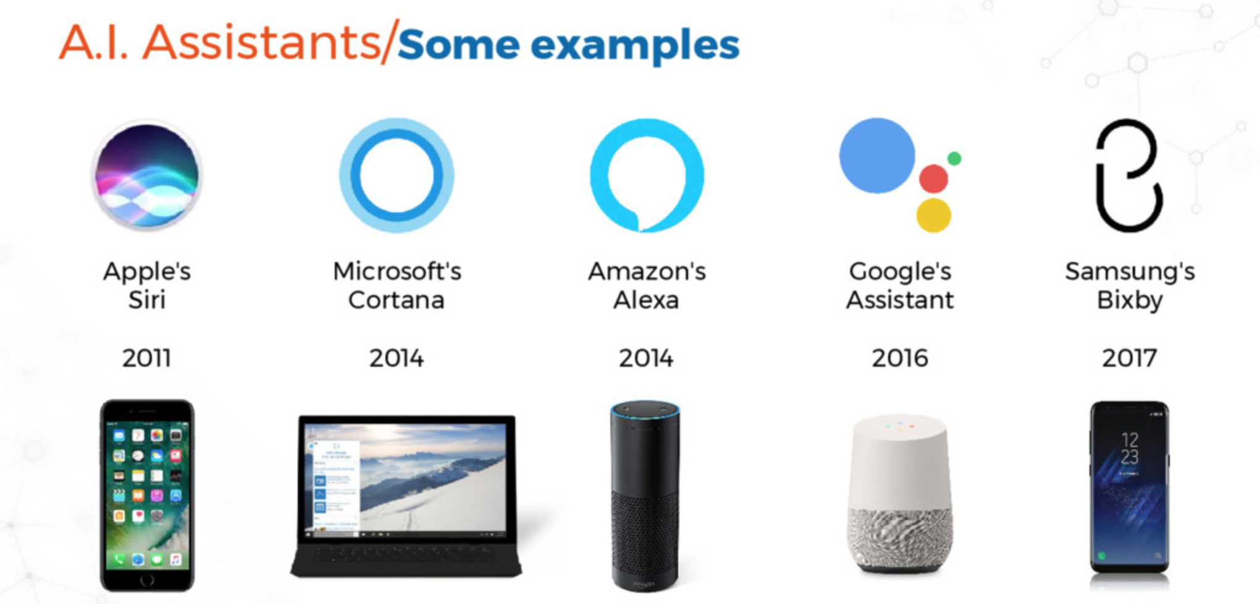

Slide 96
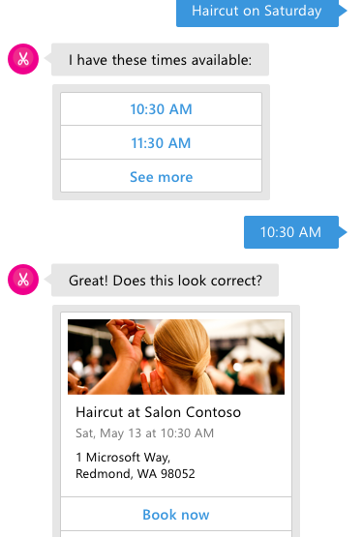
What is a Bot?
A Bot is a conversation based UI
Conversation is based on language
Conversation takes place on a general canvas
Canvas can be: Chat Client: Skype, Team, Slack, Messenger Voice: Echo, Cortana Skills, Siri, Google Now App: Website, App

Slide 97
Scenario’s for Bots
Question and Answers
Automate Helpdesk, Handoff to human if too complex
Product selection and ordering
Task Automation
Proactive Assistance & Monitoring
Expert Systems

Slide 98
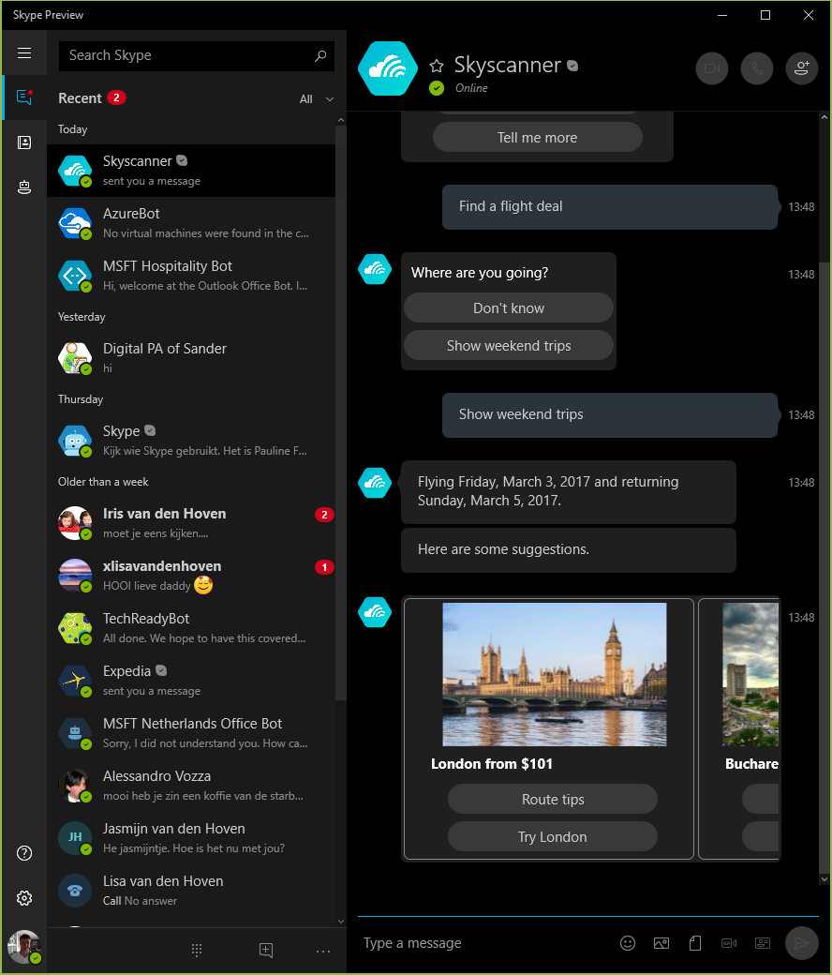
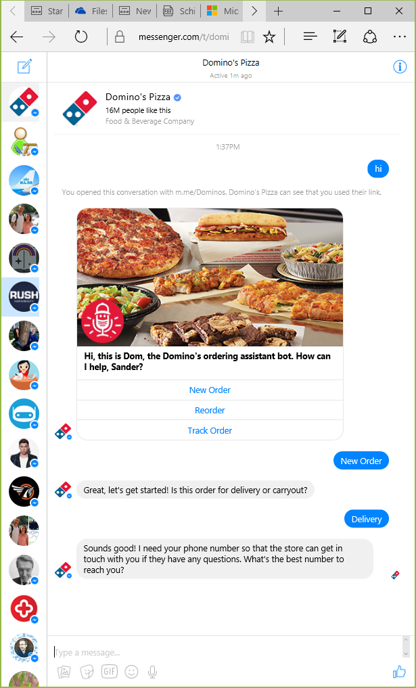
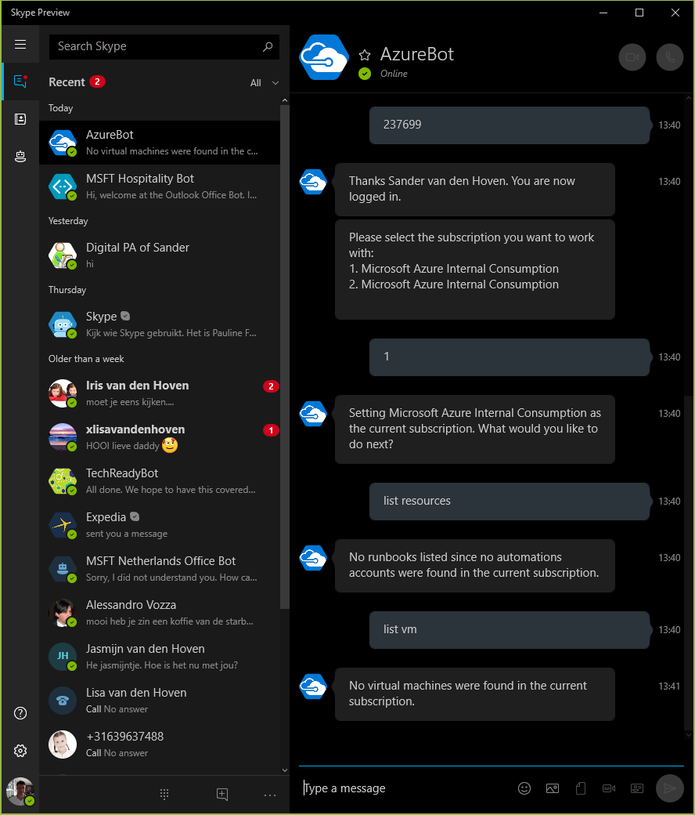
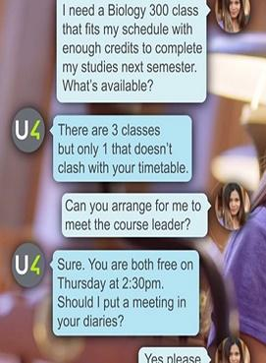
Bot Examples

Slide 99
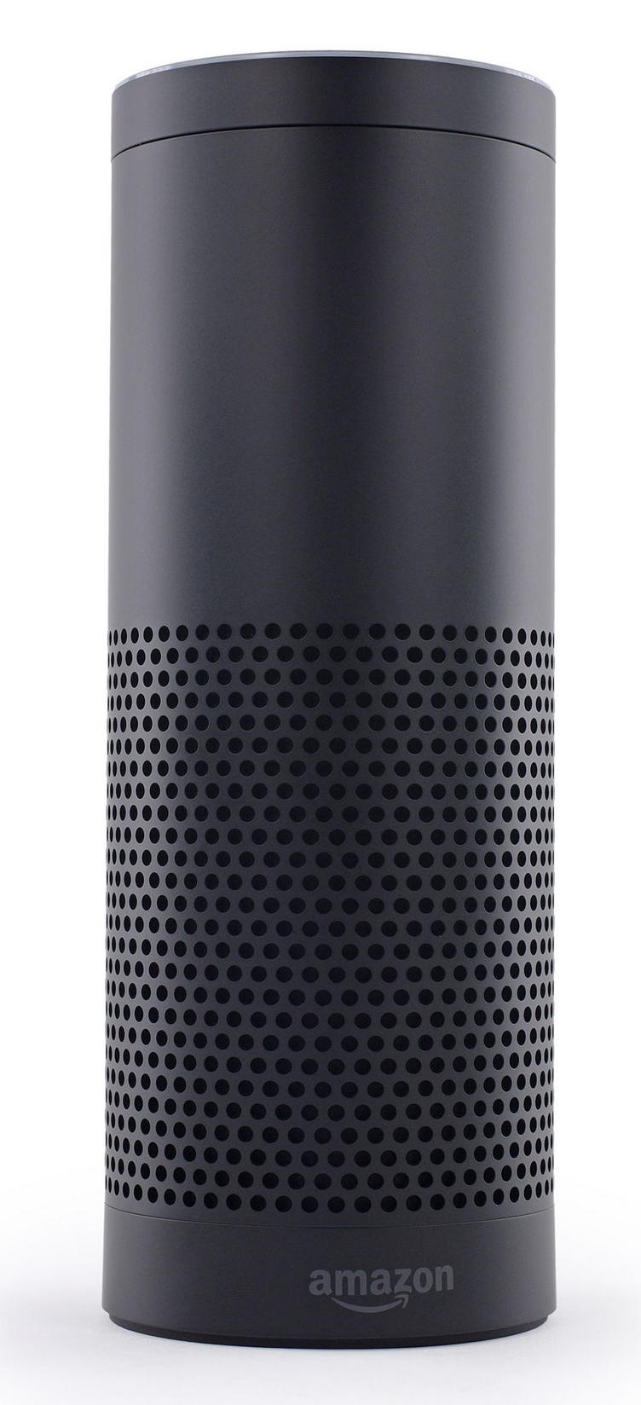
Embedded devices with dialogue capabilities
Amazon Echo (2014) – home assistant device
Plays music
With voice commands
Question answering
Get weather, news
More complex questions, like
“how many spoons are in a cup?”
Setting timer
Manages TODO lists

Slide 100
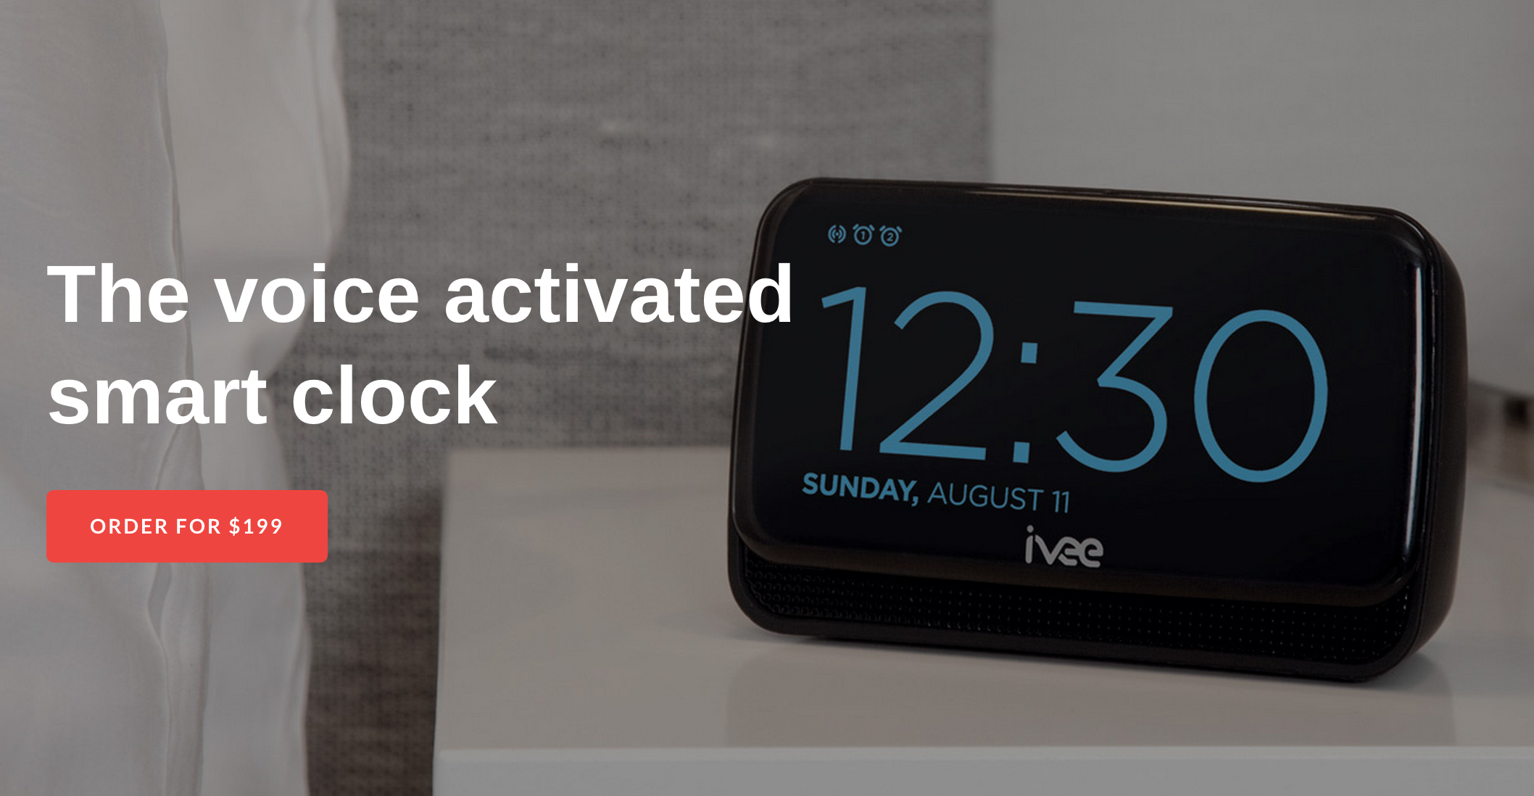
Embedded devices with dialogue capabilities
Answers questions
Sets time
Device control and queries.
Thermostat Etc.

Slide 101
Dialogs are for bots like screens are for apps
They separate concerns and organize flows, exactly the same way:
Traditional Application
Bot
Main Screen
Root Dialog
New Order Screen
Product Search Screen
New Order Dialog
Product Search Dialog

Slide 102
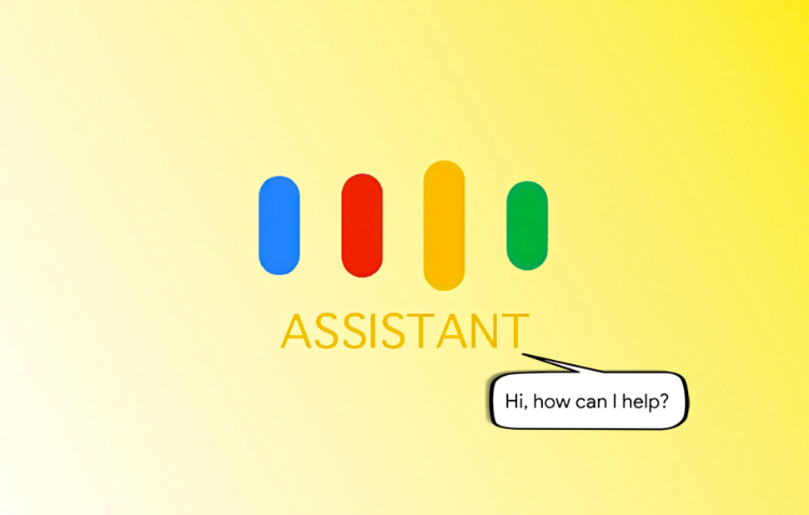


Slide 103
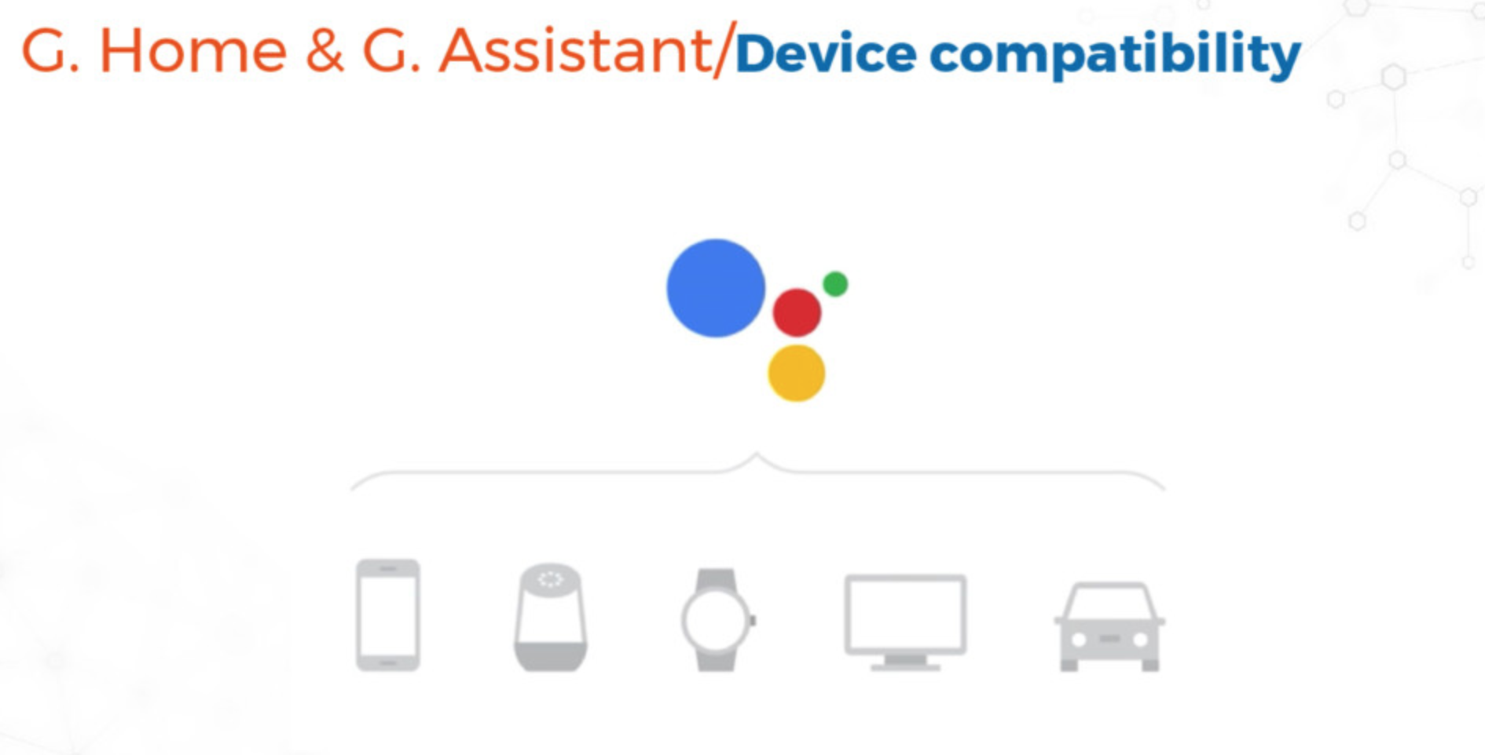

Slide 104
Google Assistant coming soon to more speakers, appliances and other devices
Google is putting its Assistant on a wide range of third-party hardware. Google has announced that it’s going to be putting the Assistant on partner speakers, appliances, connected cameras, and much more.
It is already on the iPhone.

Slide 105
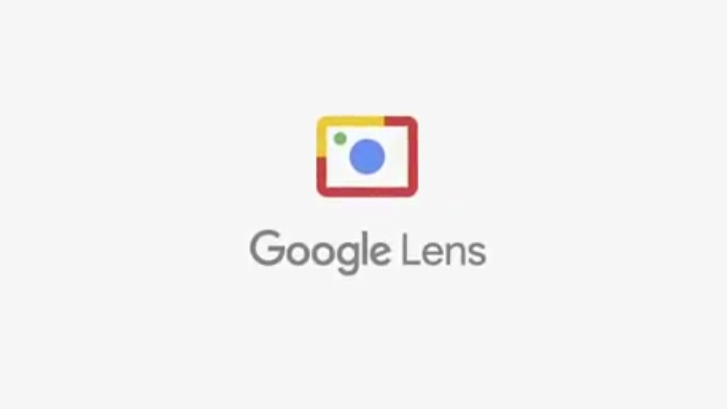
Google wants to ‘see’ as well as ‘hear’ your surroundings

Slide 106
How to develop for the Google Assistant platform

Slide 107
Actions on Google https://developers.google.com/actions/
Actions on Google is a developer platform that lets you create software to extend the functionality of the Google Assistant, Google’s virtual personal assistant, across more than 500 million devices, including smart speakers, phones, cars, TVs, headphones, watches, and more.
You can build smart home Actions that let users control Internet of Things (IoT) devices through the Google Assistant. Building smart home Actions lets you connect, query, and control devices through your existing cloud infrastructure.

Slide 108
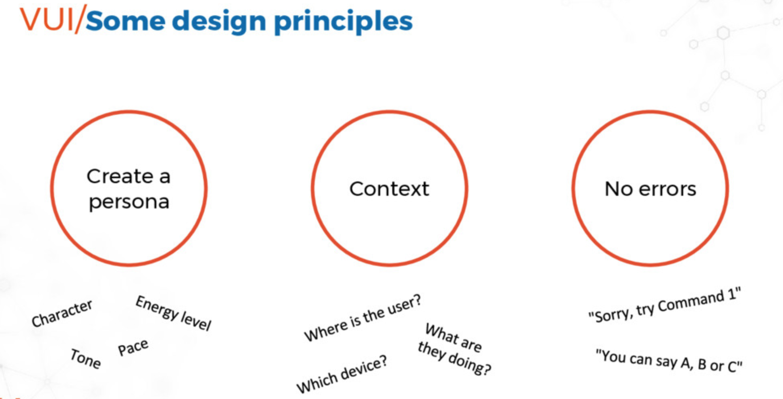

Slide 109
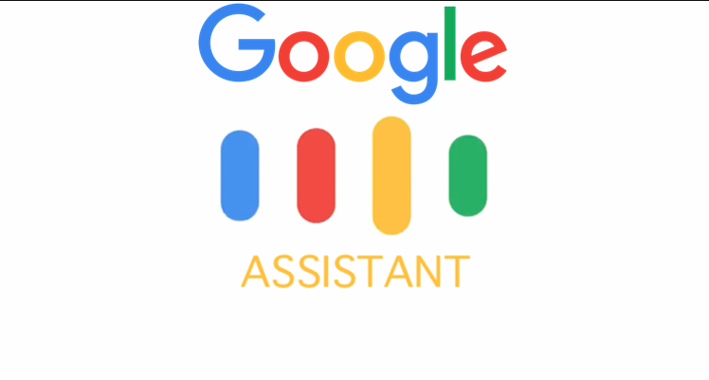
Our Voice Platform

Slide 110
IoT Open Source Software which we will use
MCU: Bare Metal Programming with Embedded Rust
Edge/Gateway: Rust, JavaScript (Node.js) and WebAssembly Microservices running on Linux Raspbian, Docker, Kubernetes, MQTT and KubeEdge
Cloud: Rust, JavaScript (Node.js), and WebAssembly Microservices running on Linux Ubuntu, Docker, Kubernetes, Serverless and Kafka

Slide 111
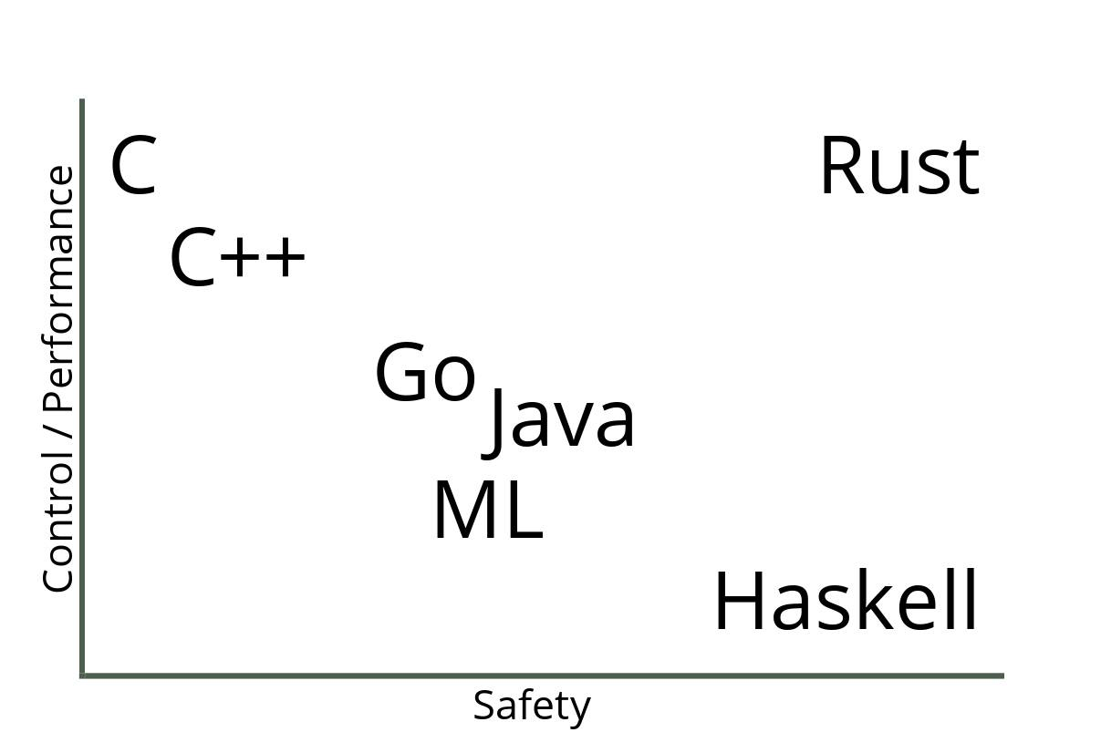
Rust: Performance with Safety

Slide 112
Our Messaging Protocols: Kafka and MQTT
MQTT is a publish/subscribe protocol particularly suited to IoT applications thanks to its small footprint, real-time guarantees, and suitability for use in high-latency, low-throughput, and unreliable networks. It is designed for connections with remote locations where a "small code footprint" is required or the network bandwidth is limited. The publish-subscribe messaging pattern requires a message broker.
Based on a publish/subscribe model, Kafka is one of the most widely used platforms to process and distribute real-time data streams. It is used for building real-time data pipelines and streaming apps. It is horizontally scalable, fault-tolerant, wicked fast, and runs in production in thousands of companies.
Both, MQTT and Apache Kafka have great benefits for their own use cases. But, none of them are the single allrounder for everything. The combination of both makes them very powerful and a great solution to build IoT end-to-end scenarios from the edge to data center and back.
Notes:
Read: https://dzone.com/articles/apache-kafka-mqtt-end-to-end-iot-integration-githu
https://thenewstack.io/apache-kafka-cornerstone-iot-data-platform/

Slide 113
Our Orchestrator: Why the IoT needs Kubernetes
Kubernetes has become the de-facto standard container orchestration framework for cloud-native deployments. Kubernetes addresses many of the complexity challenges that development teams see when building and deploying IoT solutions.
Enabling DevOps for IoT
Scalability
High availability
Efficient use of cloud resources
Deployment to the IoT edge
Kubernetes IoT Edge Working Group https://www.youtube.com/watch?v=OeuOzMvGDM0
Notes:
https://blog.bosch-si.com/bosch-iot-suite/why-the-iot-needs-kubernetes/
In fact, Kubernetes addresses many of the complexity challenges that development teams see when building and deploying IoT solutions.
Enabling DevOps for IoT
Customer and market demands often require IoT solutions to have the ability to quickly deploy new features and updates. Kubernetes provides a unified deployment model that allows DevOps teams to quickly and automatically test and deploy new services. It supports zero-downtime deployments in form of rolling updates. This allows mission-critical IoT solutions to be kept up-to-date with no impact on end users (customers).
Scalability
Scalability is a key concern for many IoT solutions. The ability to handle thousands or even millions of device connections, sending terabytes of data and messages and providing services such as real-time analytics requires a deployment infrastructure that can scale up and down to meet the demands of an IoT deployment. Kubernetes provides the ability to automatically scale Kubernetes Pods across network clusters.
High availability
Many IoT solutions are considered business critical systems that need to be reliable and available. For instance, an IoT solution critical to the operation of a factory needs to be available at all time. Kubernetes provides the tooling required to deploy highly available services. It’s architecture also allows for workloads to run independently. In addition, they can be restarted or recreated with no effect to end-users.
Efficient use of cloud resources
IoT solutions are often a set of connected services. They handle device connectivity and management, data ingestion, data integration, analytics or integration with IT and OT systems, among others. These services will often run on public cloud providers, such as AWS or MS Azure. This makes the efficient use of cloud provider resources an important consideration towards the total cost to manage and deploy these services. Kubernetes creates an abstraction layer on top of the underlying virtual machines. Administrators are able to focus on the deployment of the IoT services across the optimal number of VMs as opposed to a single service on a single VM.
Deployment to the IoT edge
A key trend in the IoT industry is the deployment of IoT services to the edge of the network. For instance, to improve the responsiveness of a predictive maintenance solution, it might be more efficient to deploy the data analytics and machine learning services closer to the equipment being monitored. Running IoT services in a distributed and federated manner creates a new management challenge for system administrators and developers. However, Kubernetes provides a common platform that could be used for deploying IoT services at the edge. In fact, a new Kubernetes IoT Working Group is investigating how it can provide a consistent deployment model for IoT cloud and IoT Edge.
The Kubernetes community is rapidly advancing and innovating around the Kubernetes platform. These advancements are making it possible to build cloud-native IoT solutions that are scalable, reliable and deployed in a distributed federation. It is clear Kubernetes has become a key enabling technology for IoT solutions.

Slide 114
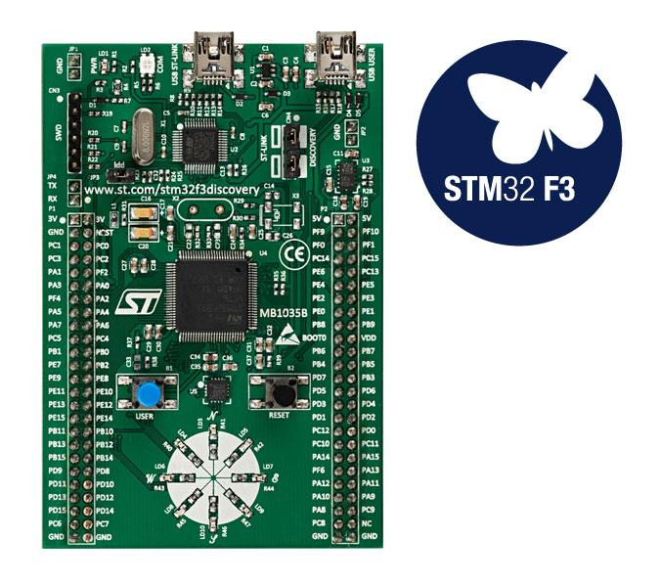
Hardware which we will use: Microcontroller
The STM32F3DISCOVERY allows users to easily develop applications with the STM32F3 Series based on ARM® Cortex®-M4 mixed-signal MCU. It includes everything required for beginners and experienced users to get started quickly.
It includes an ST-LINK/V2 or ST-LINK/V2-B embedded debug tool, accelerometer, gyroscope and e-compass ST MEMS, USB connection, LEDs and push-buttons. Price $16 in USA, and $24 on Ali Express.

Slide 115
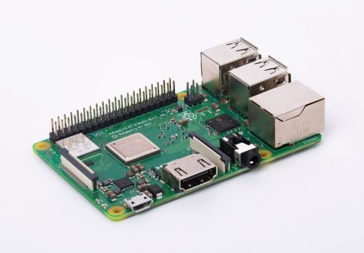
Hardware which we will use: Field Gateway/Edge
Raspberry Pi 3 Model B+
1.4GHz 64-bit quad-core processor, dual-band wireless LAN, Bluetooth 4.2/BLE, faster Ethernet, and Power-over-Ethernet support (with separate PoE HAT)
Price in USA $35

Slide 116


Our Programming Languages

Slide 117
The future of IoT is AI
As IoT devices will generate vast amounts of data, then AI will be functionally necessary to deal with these huge volumes if we’re to have any chance of making sense of the data.
Data is only useful if it creates an action. To make data actionable, it needs to be supplemented with context and creativity. IoT and AI together is this context, i.e. ‘connected intelligence’ and not just connected devices.
Traditional methods of analysing structured data and creating action are not designed to efficiently process the vast amounts of real-time data that stream from IoT devices. This is where AI-based analysis and response becomes critical for extracting optimal value from that data.
Notes:
https://www.techuk.org/insights/opinions/item/13827-the-future-of-iot-is-ai
https://www.wired.com/brandlab/2018/05/bringing-power-ai-internet-things/

Slide 118
Blockchain in the Internet of Things?
Traditional IoT systems are dependent on a centralized architecture. Information is sent from the device to the cloud where the data is processed using analytics and then sent back to the IoT devices.
With billions of devices set to join IoT networks in the coming years, this type of centralized system has very limited scalability, exposes billions of weak points that compromise network security and will become incredibly expensive and slow if third-parties have to constantly check and authenticate each and every micro-transaction between devices.
Smart contracts in blockchain networks will allow devices to function securely and autonomously by creating agreements that are only executed upon completion of specific requirements. It not only allows for greater automation, scalability and cheaper transfers (no third-party needed to oversee transactions).
With traditional centralized networks, the risk of a single point of failure disabling an entire network is a very real possibility. A decentralized blockchain network mitigates this risk with millions of individual nodes that transfer data on a peer-to-peer (p2p) basis to keep the rest of the IoT network running smoothly.
Notes:
https://cointelegraph.com/news/how-significant-is-blockchain-in-internet-of-things

Slide 119
IoT and Blockchain Complement Each Other
Blockchain technology can be used in tracking billions of connected devices, enable the processing of transactions and coordination between devices; allow for significant savings to IoT industry manufacturers. ... In an IoT network, the blockchain can keep an immutable record of the history of smart devices.

Slide 120
IoT + Cloud and Edge Computing + AI + Blockchain:
The Fourth Industrial Revolution has Begun
The combination of IoT, Cloud and Edge Computing, AI and Blockchain technologies allow machines in the Internet of Things to be able to lease themselves out, schedule and pay for their own maintenance, purchase their own replacement parts and keep their own transactional records, using blockchain.

Slide 121
Let's take a MCQ covering this Presentation:
Total Questions: 46, Total Time: 60 minutes

Slide 122
Let Us Do Some Rust and IoT Coding

Slide 123


Follow IoT on :-
https://www.facebook.com/groups/iot.dev.pk/

